Slide 1
Melnea Cass Boulevard & Windsor Street
Possible Community Garden Preservation
Community Meeting
October 20, 2020

Slide 2

What is the Grassroots Program?
Melnea Cass Boulevard & Windsor Street

Slide 3
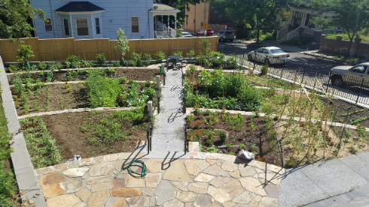
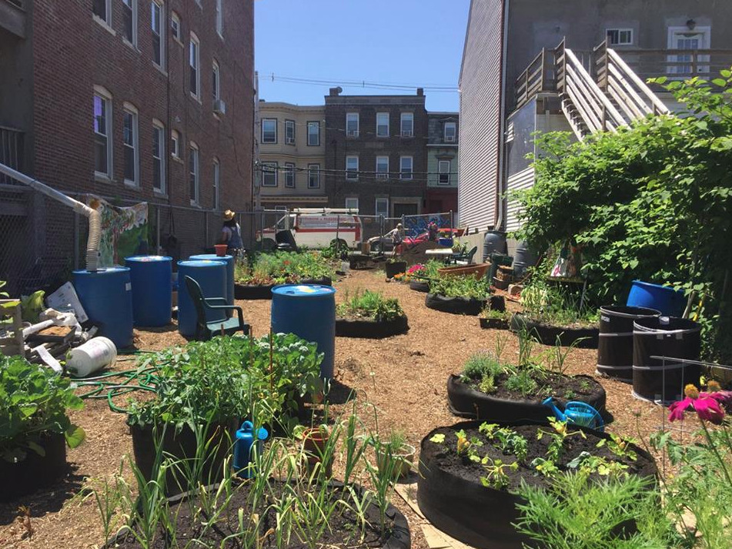
What is the Grassroots Program?
Supports the development and preservation of community gardens & other open spaces
Provides grant funds, City-owned land, and technical assistance to neighborhood groups and non-profits
Windermere Road Garden, Dorchester
Eastie Farm, East Boston

Slide 4
Site
Melnea Cass Boulevard & Windsor Street

Slide 5
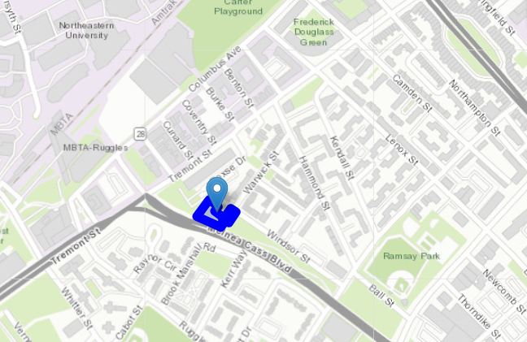
Melnea Cass Boulevard & Windsor Street - Map

Slide 6
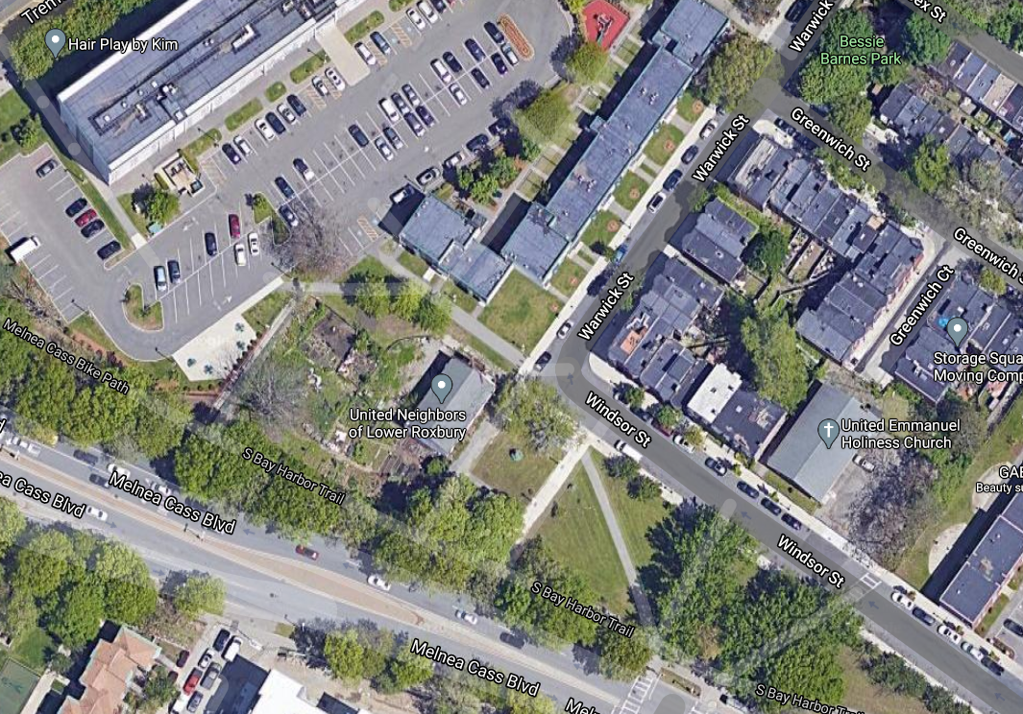
Melnea Cass Boulevard & Windsor Street - Satellite View
LOREM

Slide 7
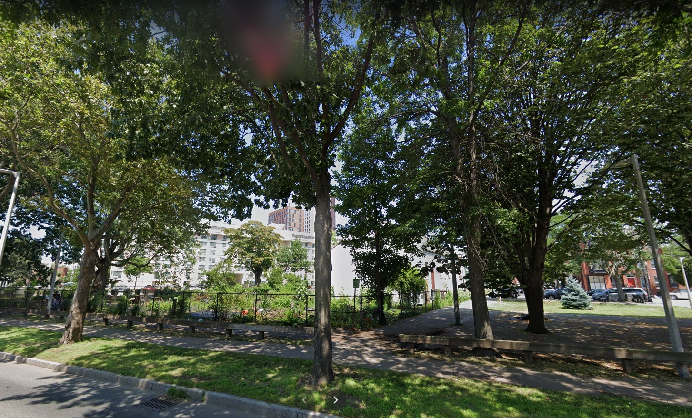
Melnea Cass Boulevard - Street View

Slide 8
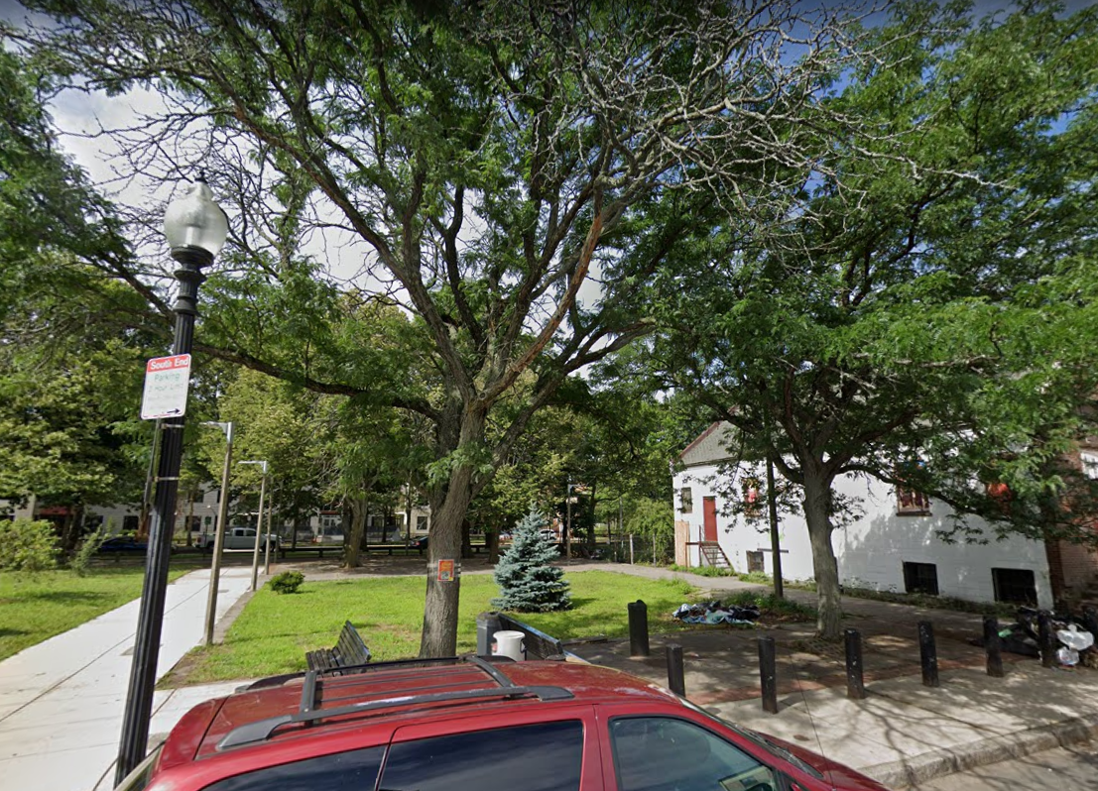
Windsor Street - Street View

Slide 9
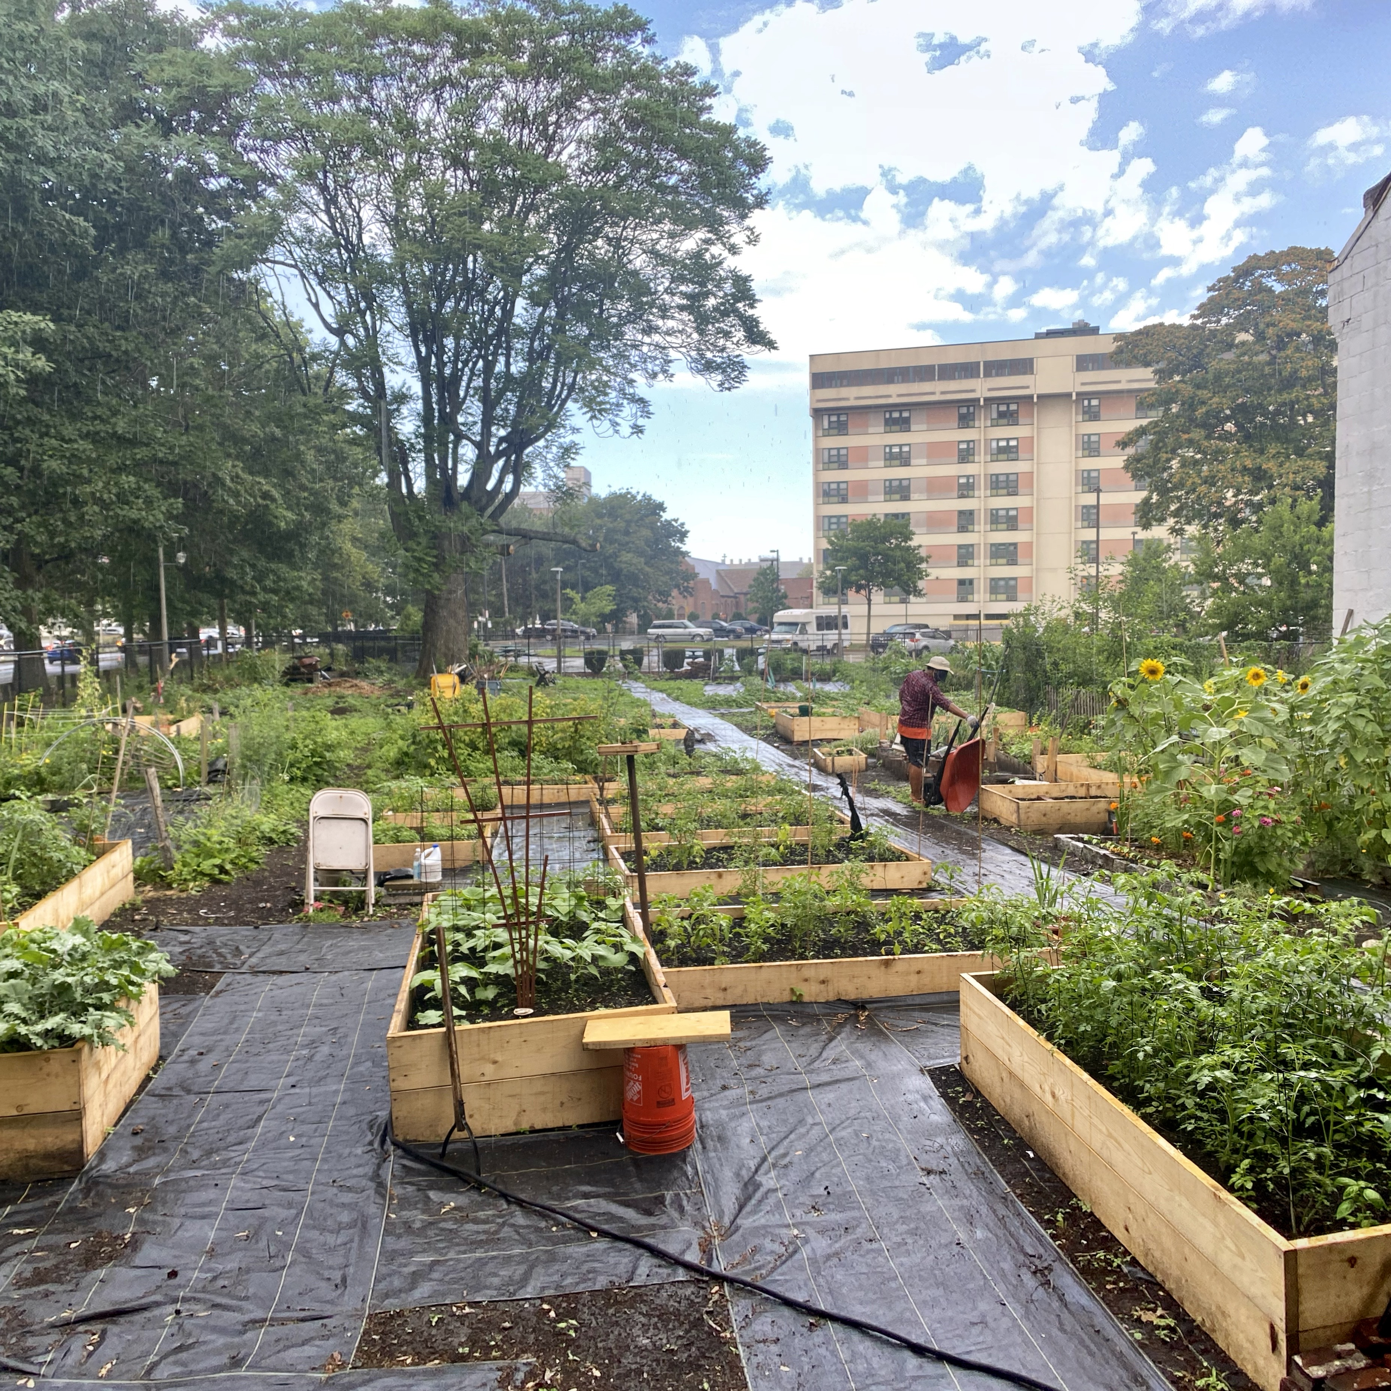
Current Community Garden

Slide 10
Discussion: Comments and Questions
Melnea Cass Boulevard & Windsor Street

Slide 11
PROPOSED FUTURE USE
Community open space
                Open year-round for public use
                Raised garden beds for community use
Permanently protected as open space

Slide 12
WE WANT TO HEAR FROM YOU!
Do you have any questions or concerns regarding the permanent use of this site as open space for community use including a community garden?
Do you want to see this space be preserved as public open space into the future?
Is there anything you would NOT want to see on this site?
Any other comments, questions, or concerns?

Slide 13
Next Steps
Melnea Cass Boulevard & Windsor Street

Slide 14
THANK YOU!
Shani Fletcher / Development Officer
(617) 635-0466 / shani.fletcher@boston.gov

