Slide 1
Albemarle Court
Landscaping Plan

Slide 2
Location

Slide 3
Existing Conditions

Slide 4
Existing Conditions

Slide 5
Summary of Planned Changes
Remove: all asphalt, 4 concrete wall planters including their trees and railings, two yellow posts
Renovate: existing painted concrete walls at all 6 staircase entrances by cladding with stone veneer
Add:
Fencing and gated entry
Landscaping - planters with granite stone borders, tree & flower plantings, grass
Hardscaping - Scored concrete walkways with granite stone border throughout
One grill and seating area not visible from public street
One fire pit and seating area not visible from public street
Additional seating areas
Paint raised foundation

Slide 6
Conceptual Rendering
Row of plantings will actually be placed between building and the walkway, reversed from what is shown here.

Slide 7
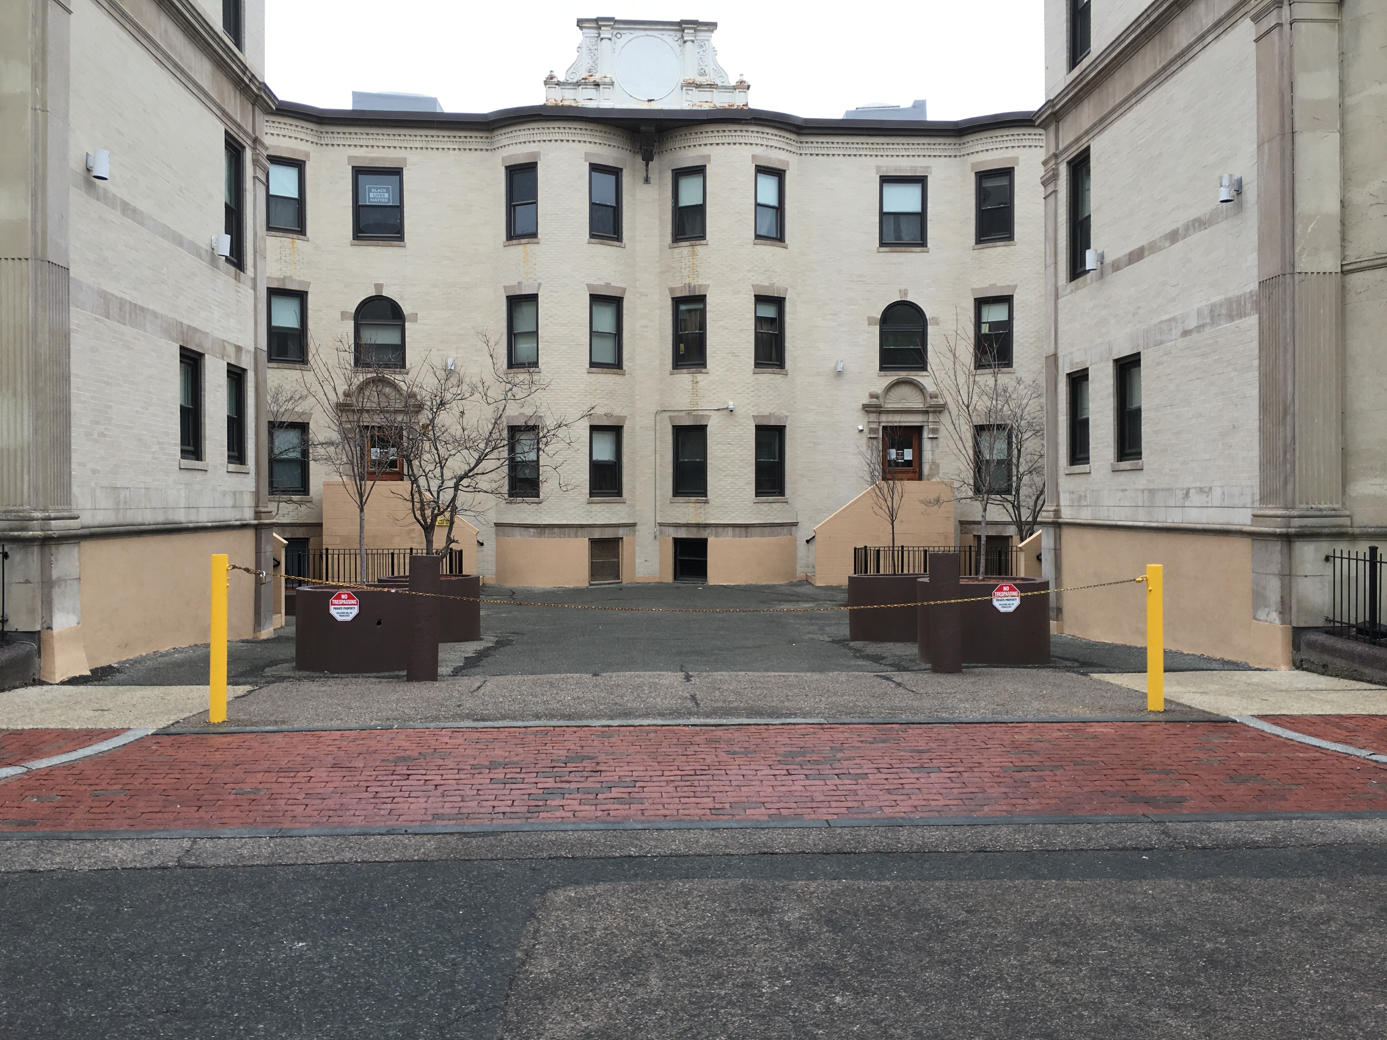
Add: Fencing and gate entry
Approx. ~50 ft. of fencing
5" feet in height
Galvanized steel
Black
Solid core
Decorative railings
Attach to exterior walls behind sidewalk
Gated entry points will not be illuminated
Attach to courtyard walls beyond corner pilaster
Span entire width of courtyard entrance
Chosen based on fencing found within the St. Botolph Street Architectural Conservation District
Notes:
Our selection: https://www.homedepot.com/p/ALEKO-Prague-Style-5-ft-x-8-ft-Black-Iron-Fence-Panel-FENCEPRA-HD/306671632 $3,510

Slide 8
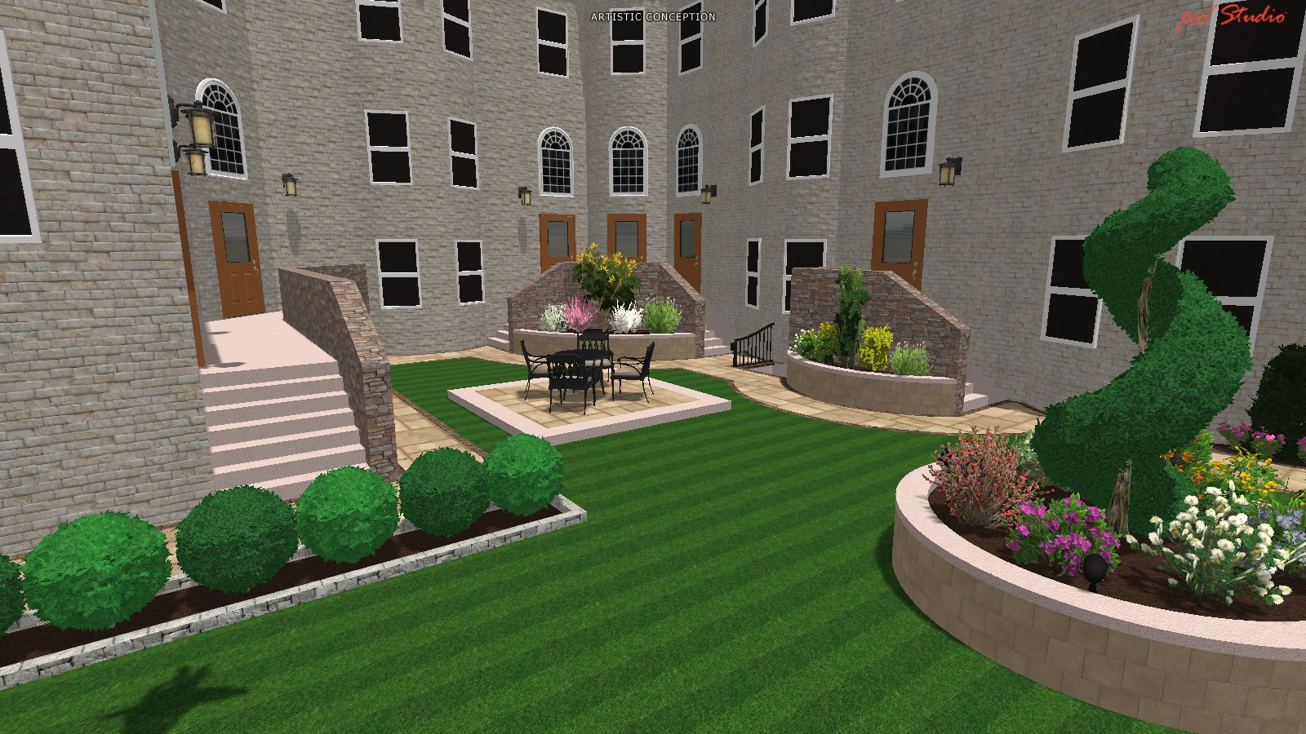
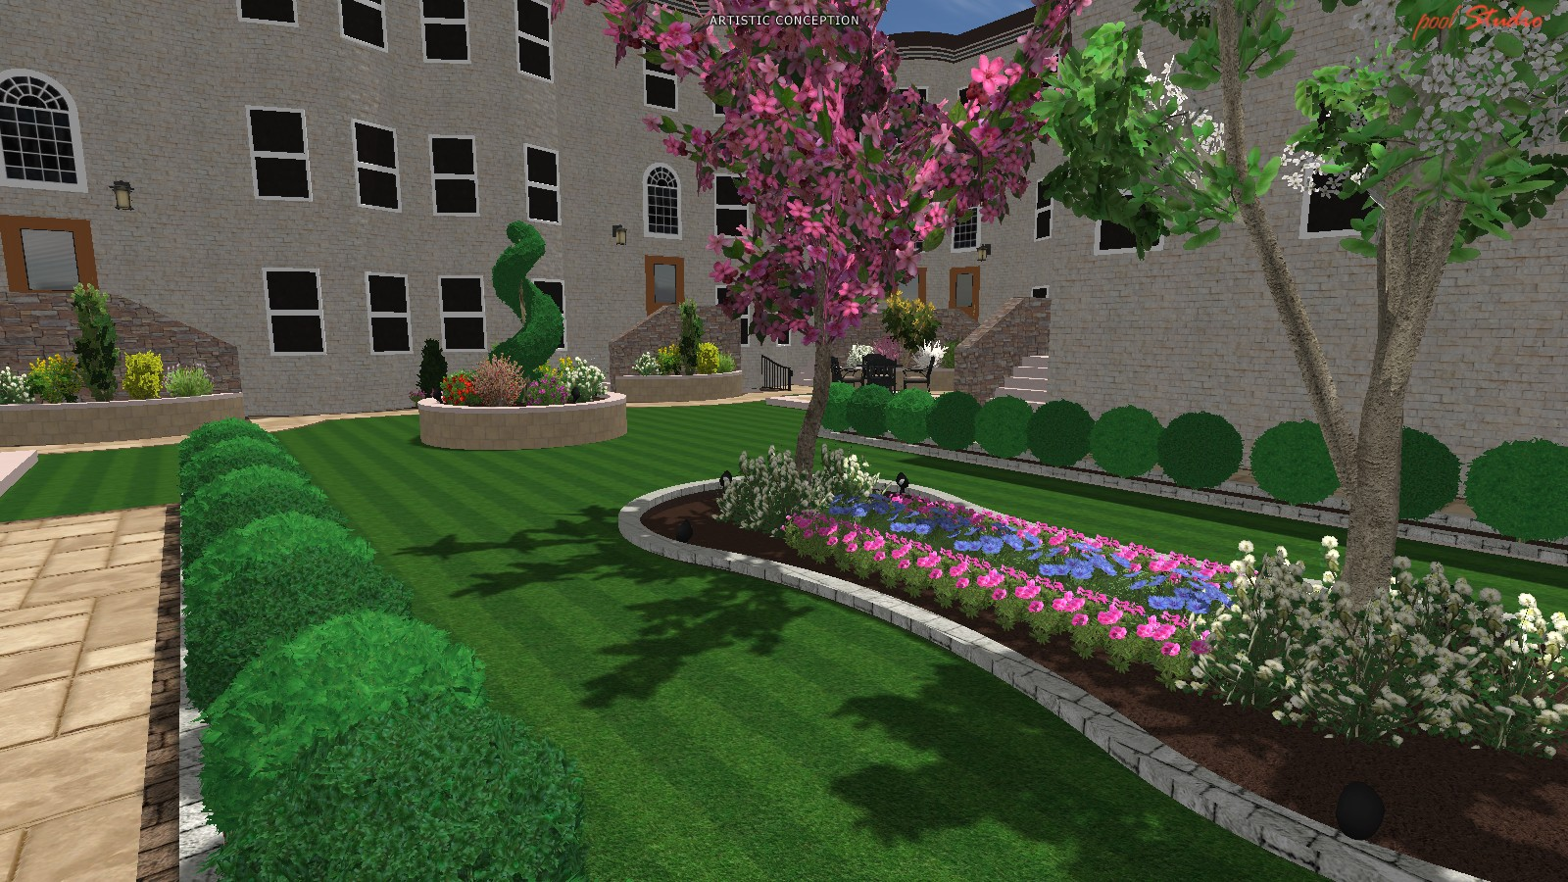
Landscaping
Install Loam throughout all landscaped areas and grade as necessary
Install high quality sod mixture throughout new lawn areas
Install 40-24”evergreen boxwood hedge
25- 3 gallon various deciduous shrubs
5- 2.5/3” deciduous trees
150 various 1 gallon perennials throughout raised and lowered planting beds and along courtyard
Install Pine Bark mulch in all newly landscaped beds

Slide 9
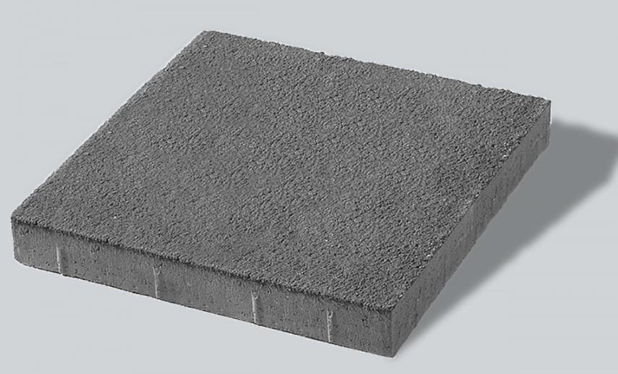
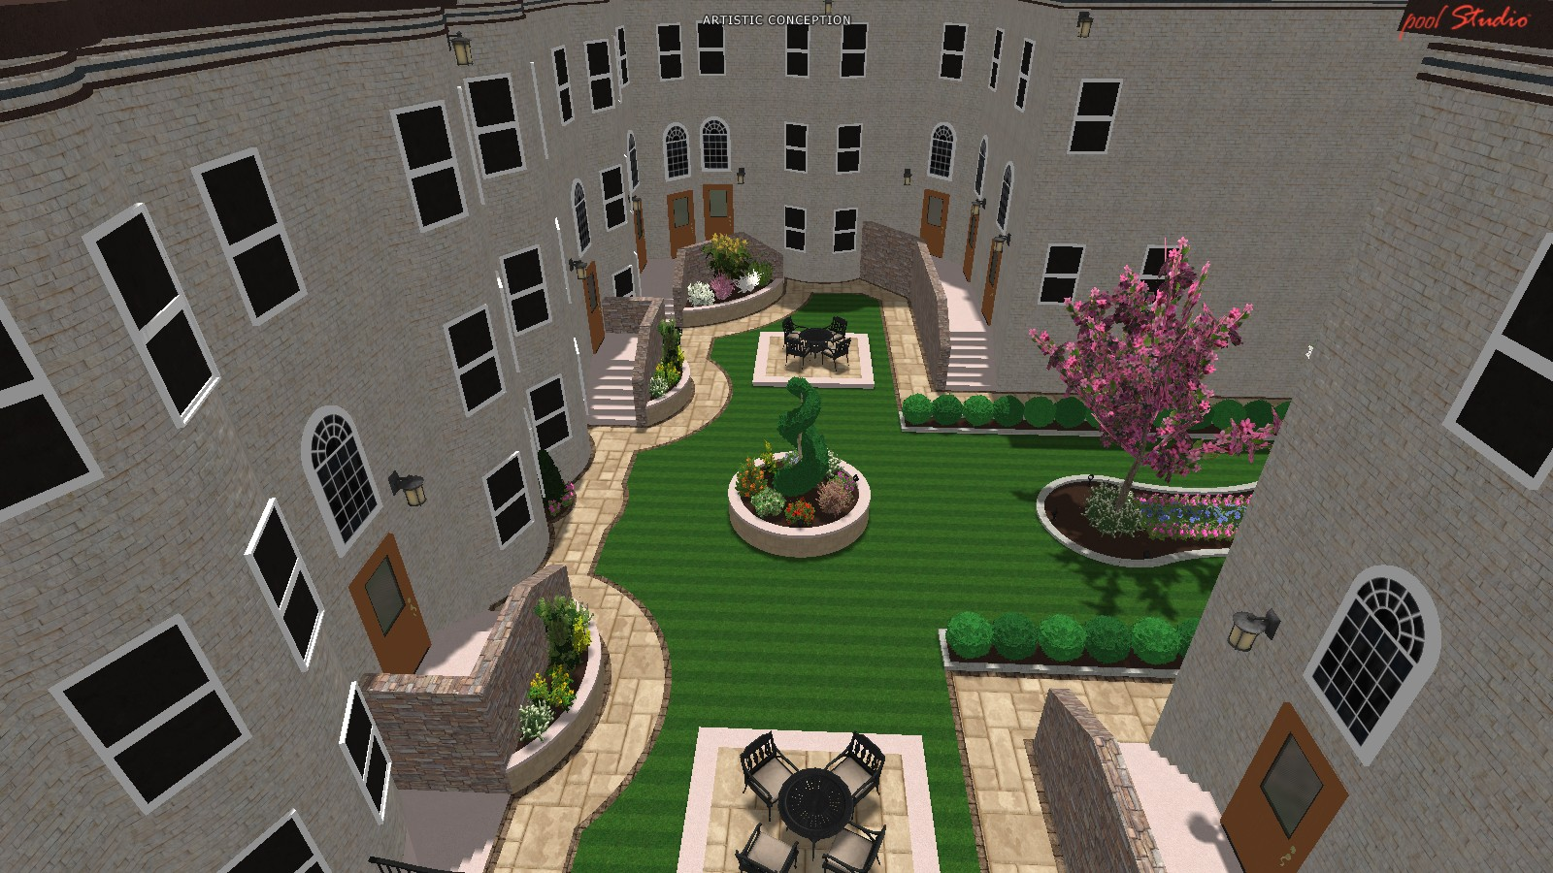
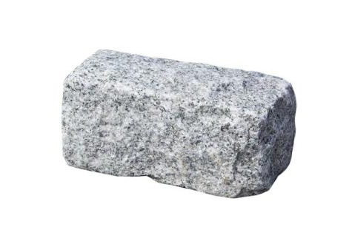
Hardscaping
Dimensions: 24”x24”x2”
Material: Concrete
Color: “Medium Grey”
Dimensions: 9”x5”x5”
Material: Granite
Color: “Gray”
Walkways
- Concrete paver and granite border (products shown on the left)
Notes:
Selection: SKYLINE™ Pavers | Unilock Boston (Paver)
Nantucket Pavers, Inc. Cobblestone 9 in. x 5 in. x 5 in. Rose Granite Edging (75-Pieces/56 Linear ft./Pallet)-20906 - The Home Depot (Granite border)

Slide 10
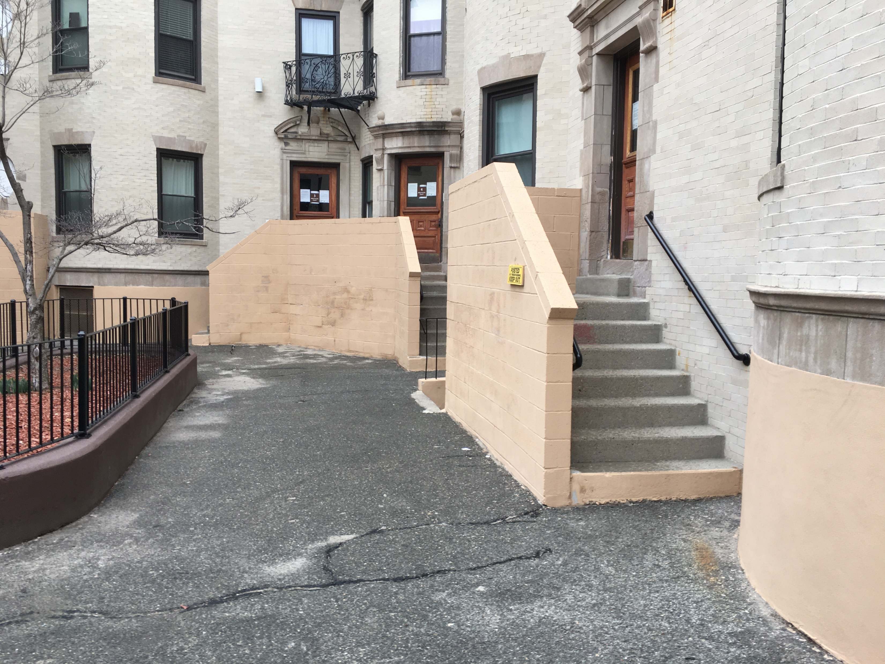
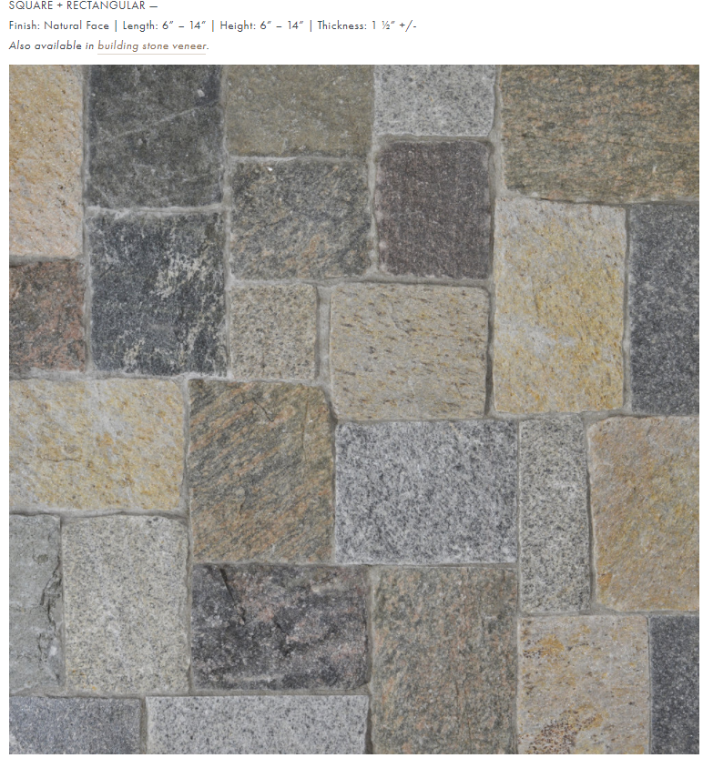
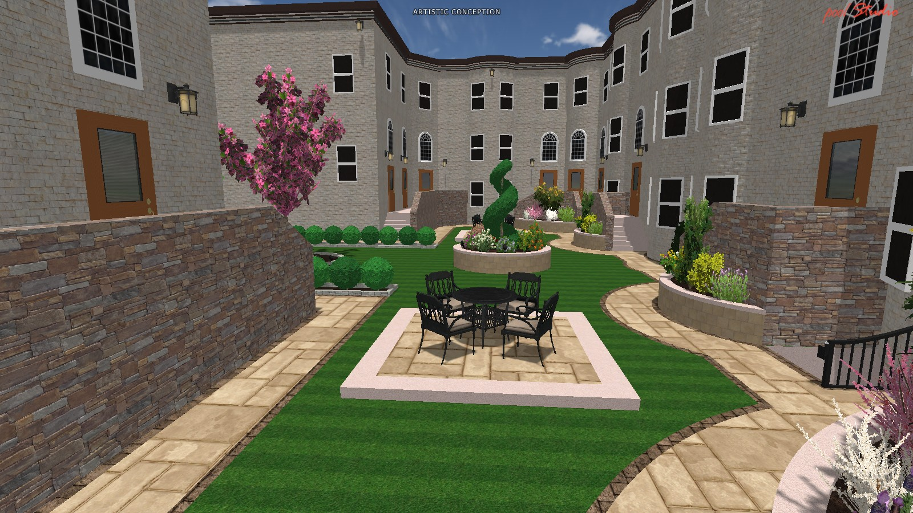
Staircase Veneer
Add stone veneer to CMU staircase enclosures
Length: 6” – 14”
Height: 6” – 14”
Thickness: 1 ½”
Material: Stone harvested from quarries across New England
Notes:
Selection: NEW ENGLAND BLEND — Phaneuf Stone (squarespace.com)

Slide 11
Paint base of building
Paint raised foundation to closely match rest of building color palette

Slide 12
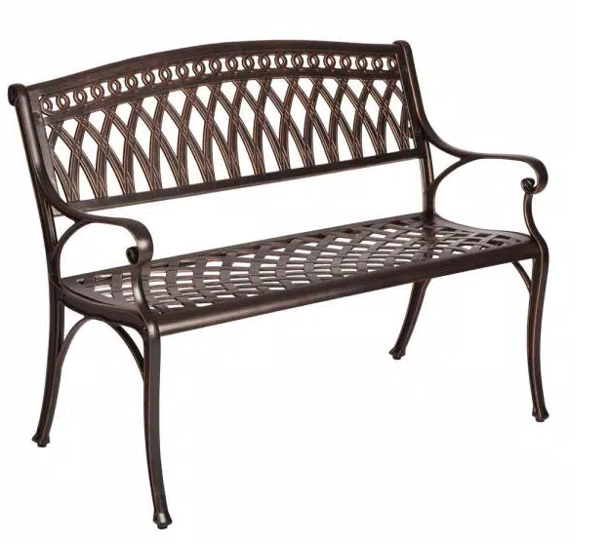
Seating x2
X
X
Antique Bronze finish
Cast aluminum
Anchored into concrete
Notes:
Selection: Patio Sense Simone 2-Person Antique Bronze Cast Aluminum Outdoor Bench-62441 - The Home Depot $604
Venetian Worldwide Alba 49 in. 2-Person Antique Oak Finish Outdoor Bench-VENE-CM-OB1806 - The Home Depot
Noble House Sebastian 65 in. Copper Aluminum Outdoor Bench-3695 - The Home Depot
Noble House Sarasota Bronze 5-Piece Aluminum Circular Outdoor Dining Set-2794 - The Home Depot
HOMESTYLES Capri Taupe Tan Brown 48 in. 5-Piece Cast Aluminum Round Outdoor Dining Set with Natural Tan Cushions-6659-325 - The Home Depot
Noble House Armstrong Multi-Brown 5-Piece Wicker Outdoor Dining Set-6176 - The Home Depot

Slide 13
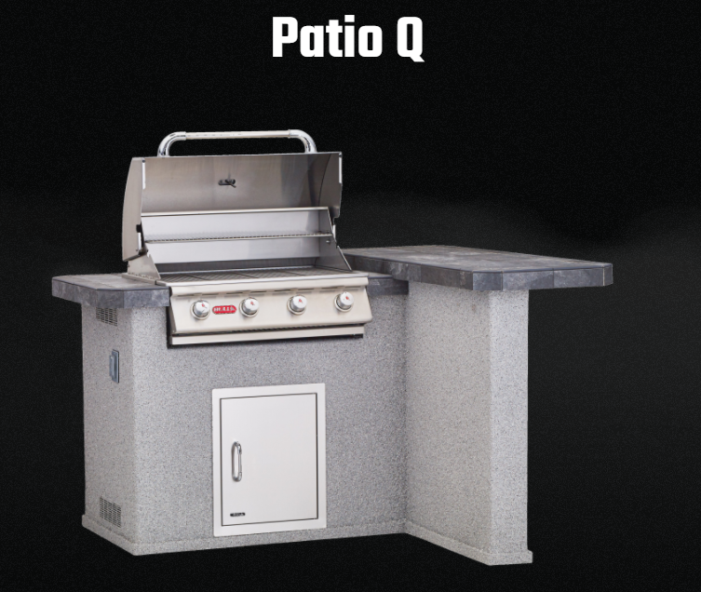
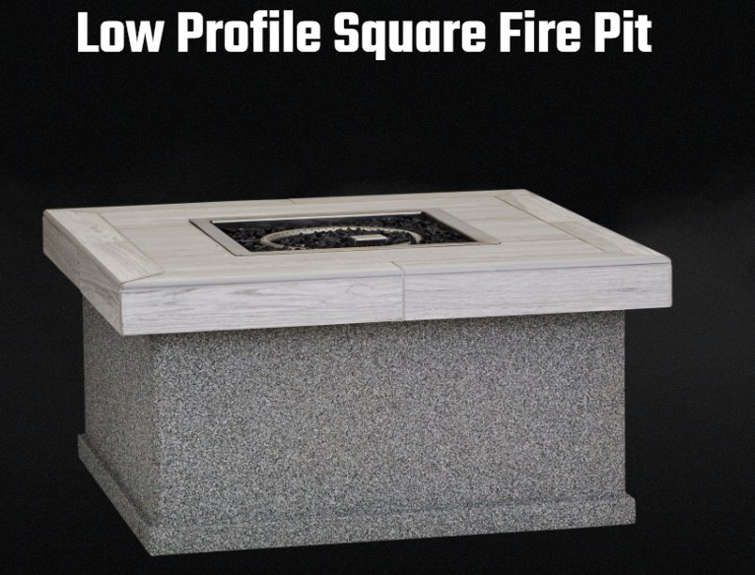
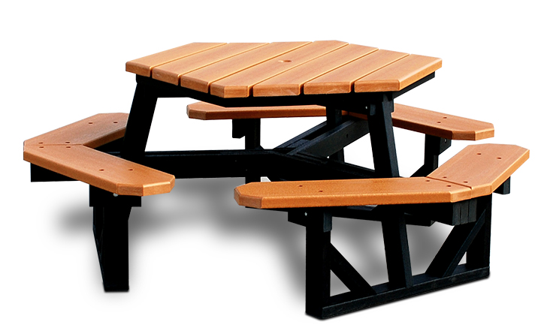
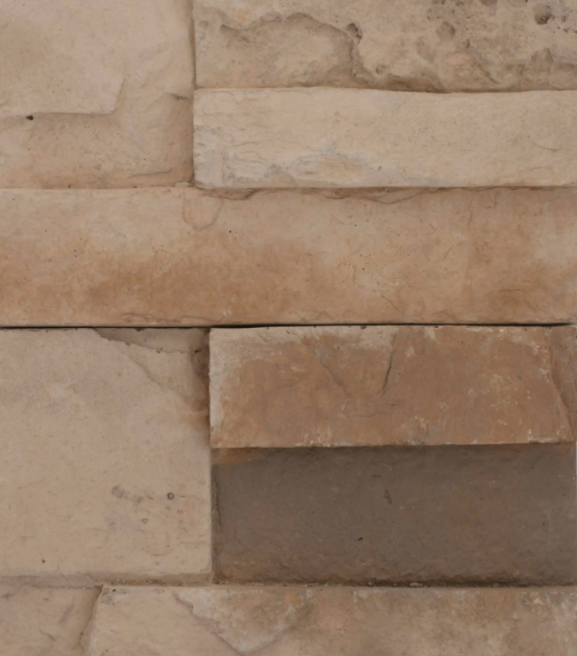
Grill and Fire Pit Selections
Frame Color
Base
Counter Top
Base
Counter Top
Top Color
Notes:
Selection: Patio Q | Bull BBQ Official Website $4,699
Hexagon Outdoor Table | Recycled Plastic | Belson Outdoors® $809
Low Profile Square Fire Pit | Bull BBQ Official Website $1,599
Select from Bull Built-In Grills : BBQGuys
Supreme Q | Bull BBQ Official Website
BBQ | Bull BBQ Official Website

Slide 14
Folder with all product spec sheets
https://schochet.sharepoint.com/:f:/g/EoBV5u692s5Euggs_IHymIUBgLaAprNwDK9eZdAY0KPnVg?e=6Nbu7L

