Slide 1
133 West Concord St
Permit Application For Front Yard Decorative Wrought Iron Enclosure

Slide 2
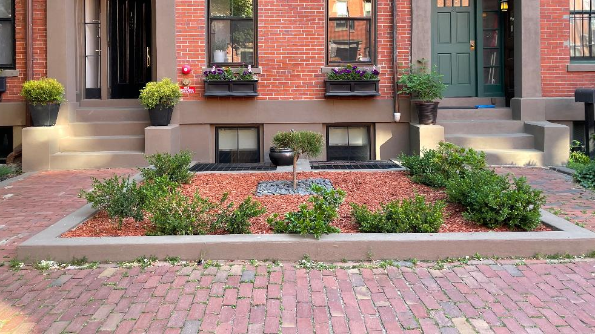
This is how our front yar currently look. We are looking to add the decorative gate for 3 reason:
This is how our front yard looks today. We are applying for the front enclosure for 2 reasons:
1) Safety – because it is widely exposed, people fee fre to come right up to our windows and look in. This room is where our little boy’s bedroom is located. 2) Beautify our front yard and the overall appeal of our street.

Slide 3
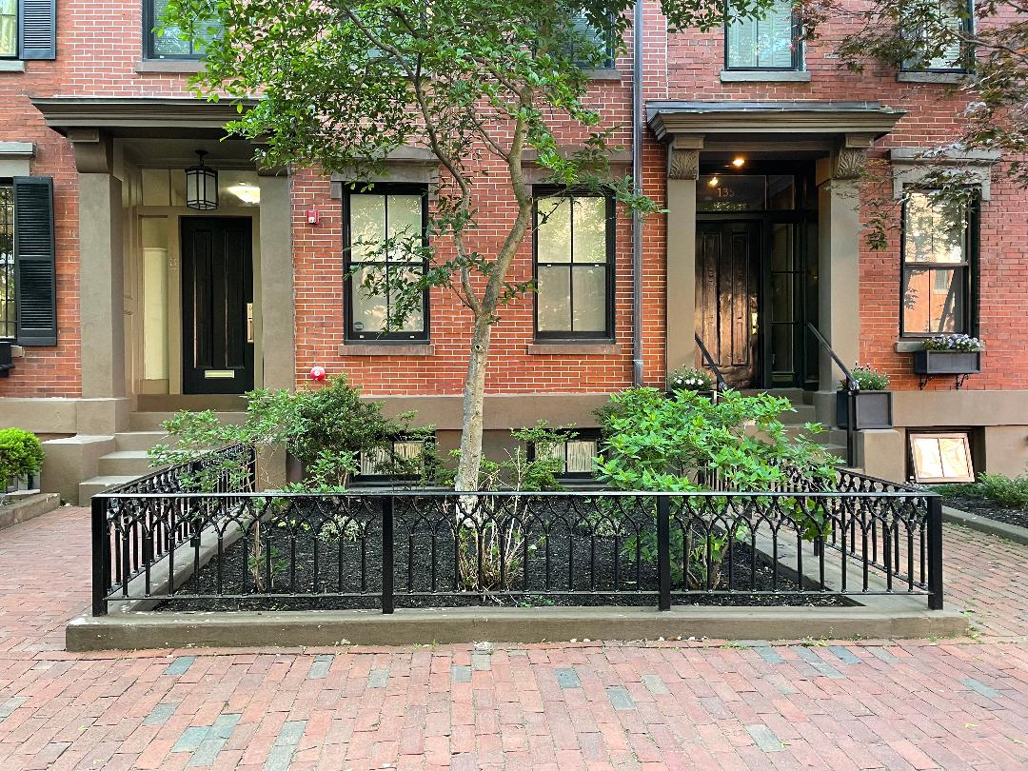
This is our neighbor, 2 buildings down from us.
Our ask is to be allowed to install the exact same enclosure.

Slide 4
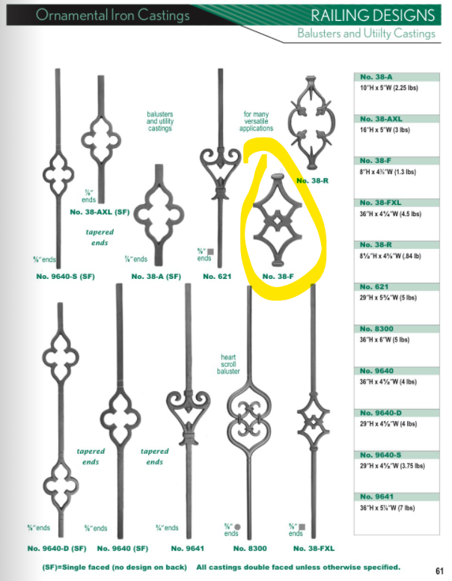
These are the dimensions of the gate. The design is from the Foundry that was provided to us by the Landmark department

