Slide 1
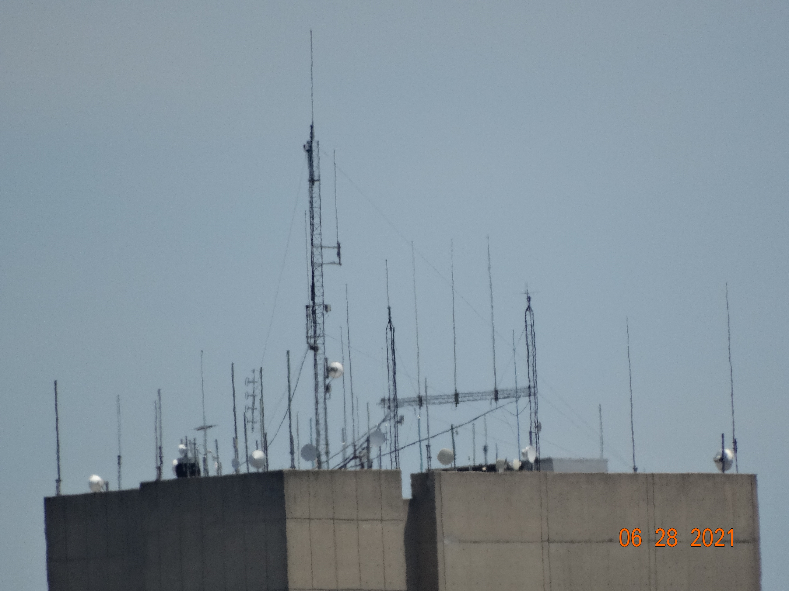
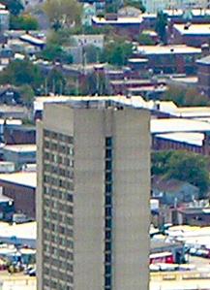
35 NORTHAMPTON ST, BOSTON
APP # 21.1006 SE

Slide 2
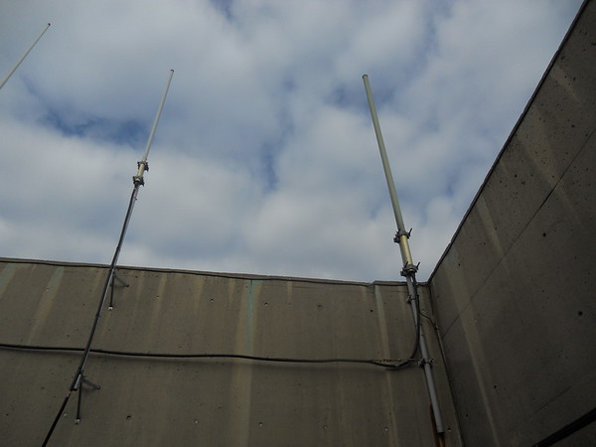
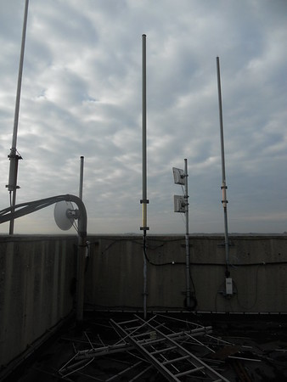
Existing Equipment at Site Location
35 Northampton Street
Boston, MA
Description of Proposed Work:
At the roof, remove and replace Boston Fire Department existing 5 antennas, 2 GPS antennas, and remove and replace radio equipment in lower existing equipment room.

Slide 3
Proposed Equipment – dbSpectra DSF03P36U Series Antenna

Slide 4
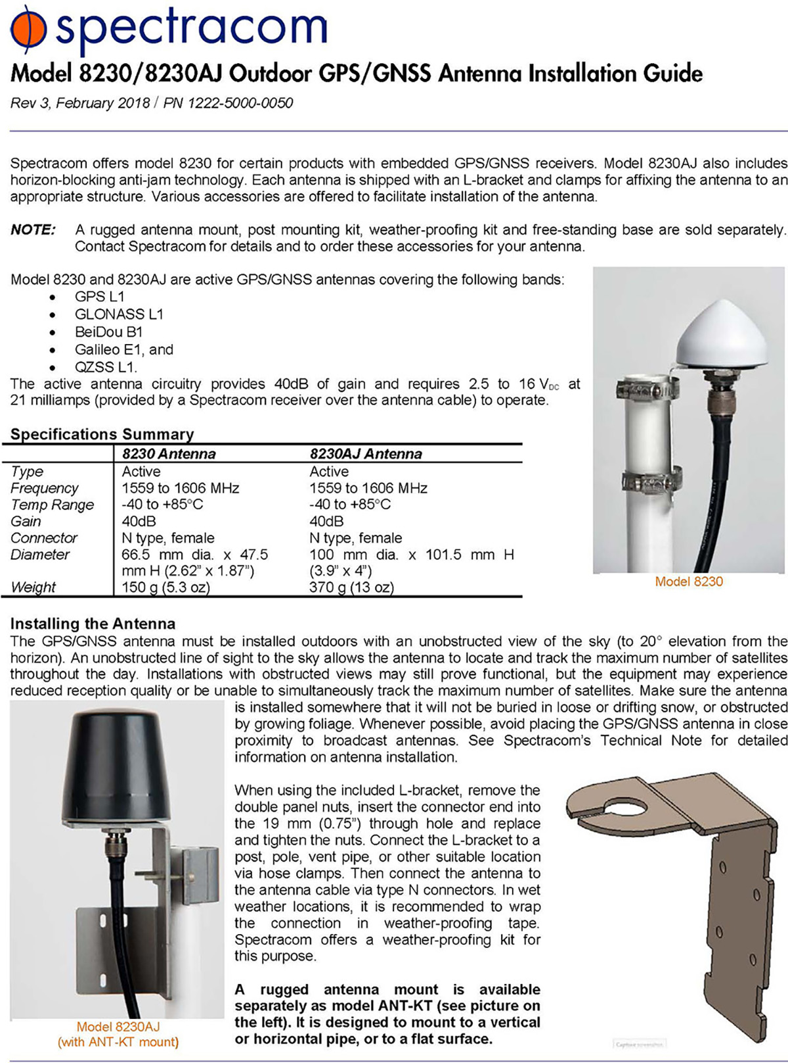
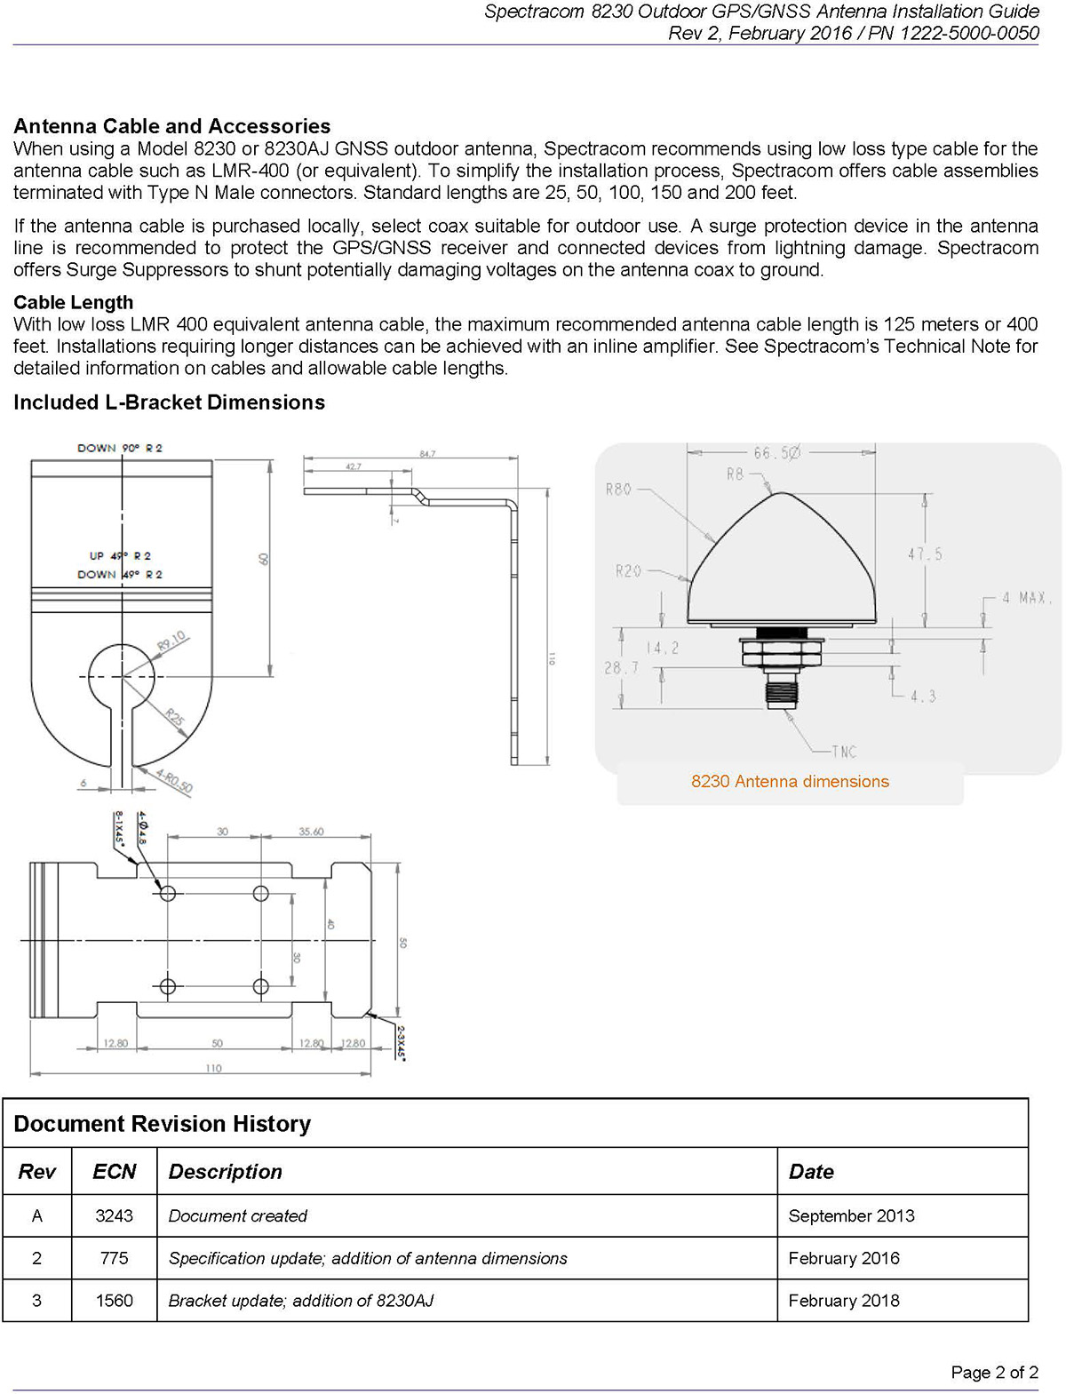
Proposed Equipment – Spectracom 8230 Outdoor GPS Antenna

Slide 5
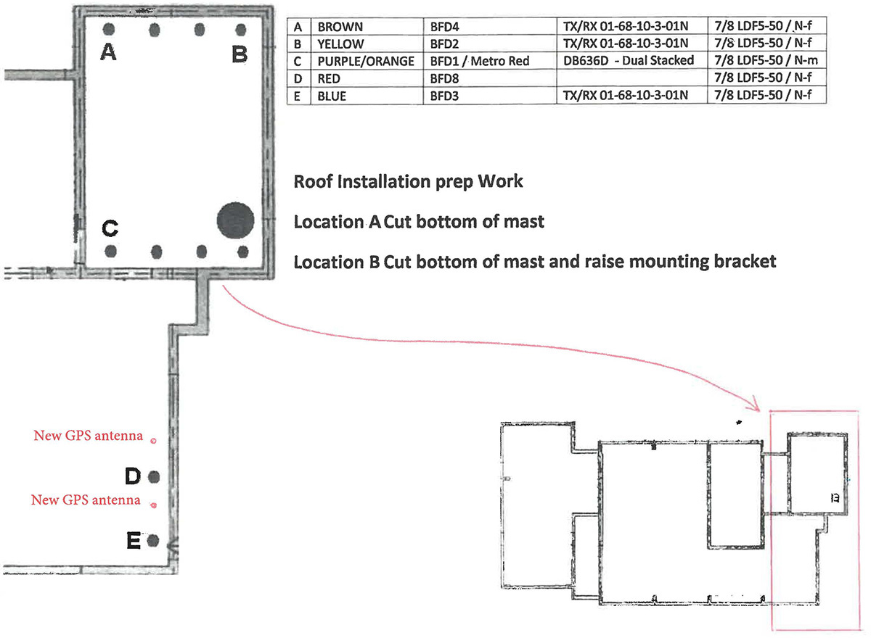
Roof Installation Prep Work

Slide 6
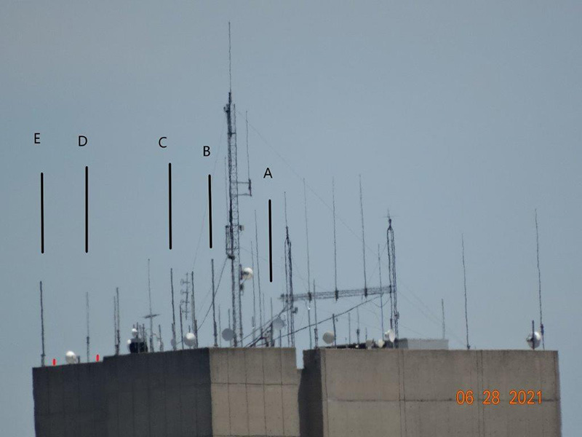
New and Replacement Antennas

