Slide 1
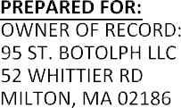





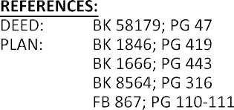




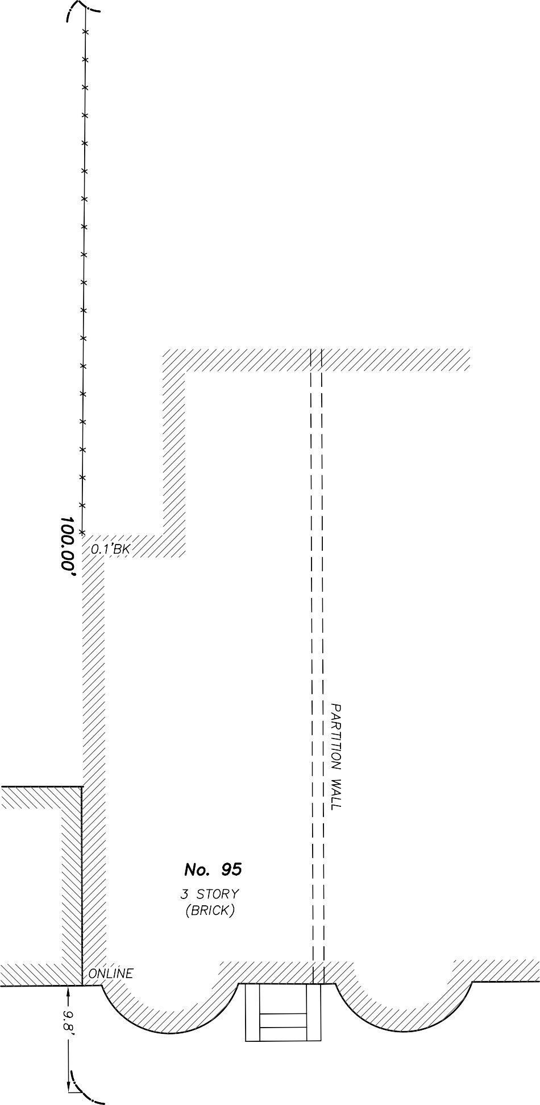



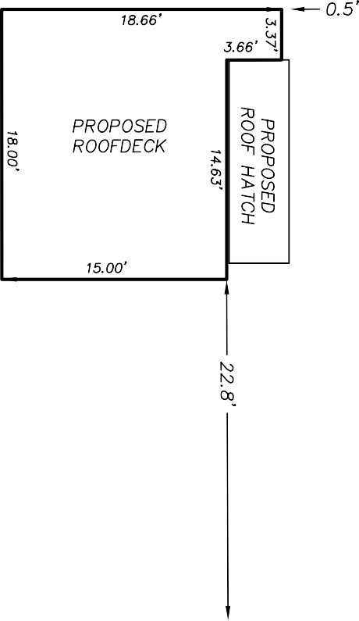



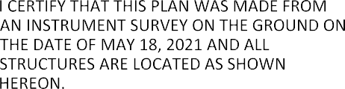






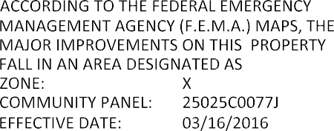



Slide 2
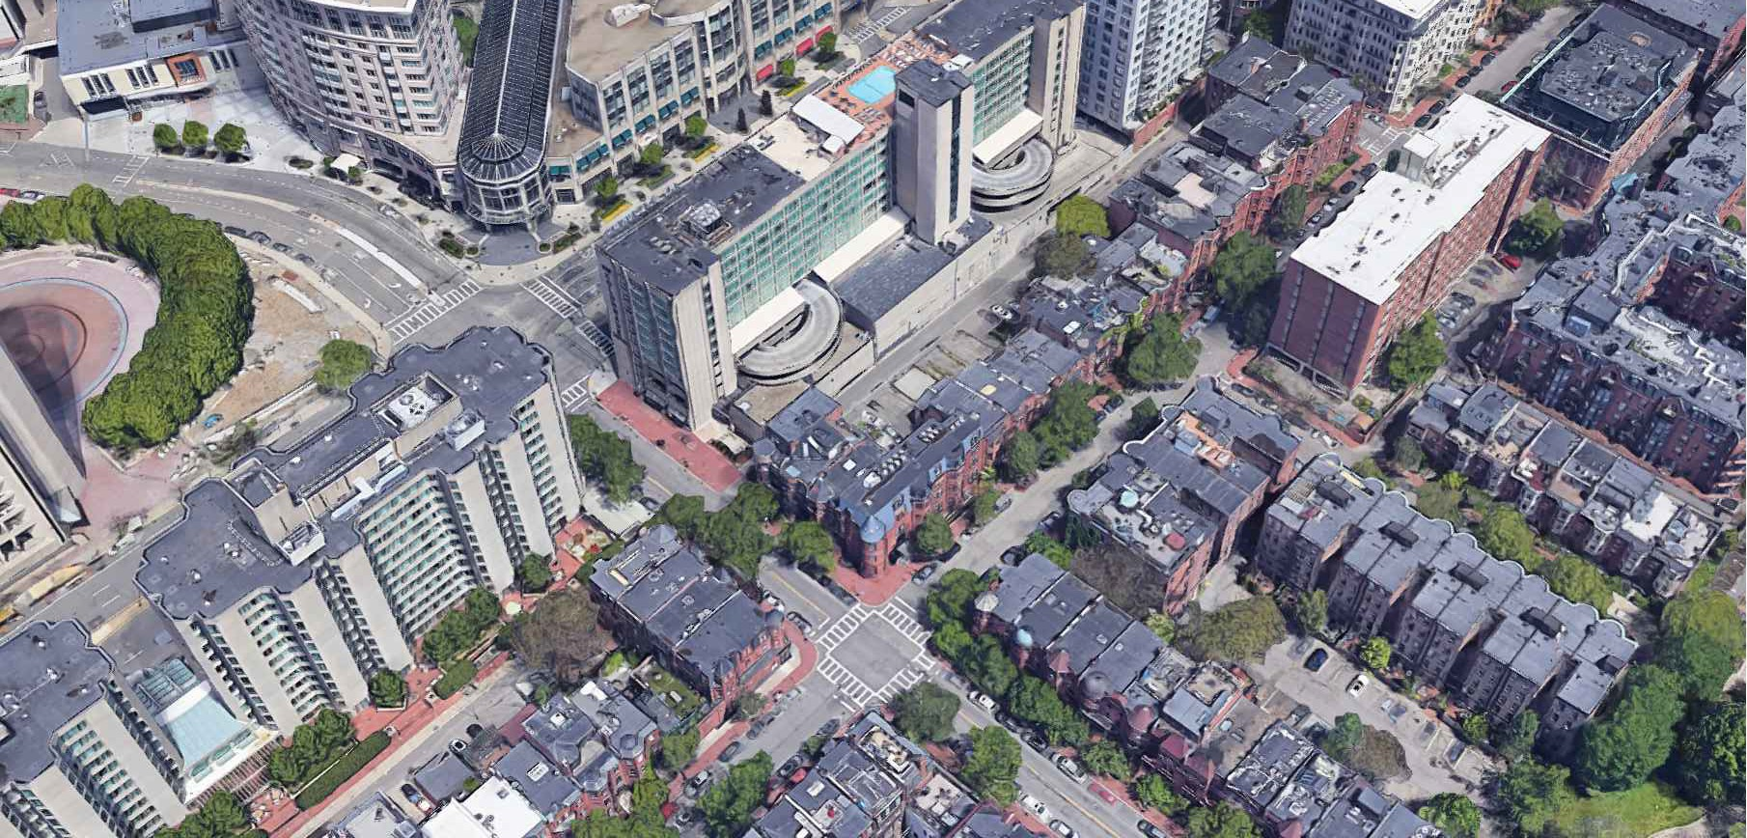



PROPOSED ROOF DECK UNIT 3
95 ST BOTOLPH ST BOSTON, MASS
HUNTINGTON AVE
PA 402
FOLLEN
C
hoo
&Company, Inc.
ST BOTOLPH ST
One Billings Road Quincy, MA 02171
617-786-7727 fax 617-786-7715
W NEWTON ST
□
 
BIRDSEYE FROM THE SOUTH
 □

2021098
AS NOTED
04-14-2021
SL

 
 
PROPOSED SITE CONTEXT
 □


Slide 3
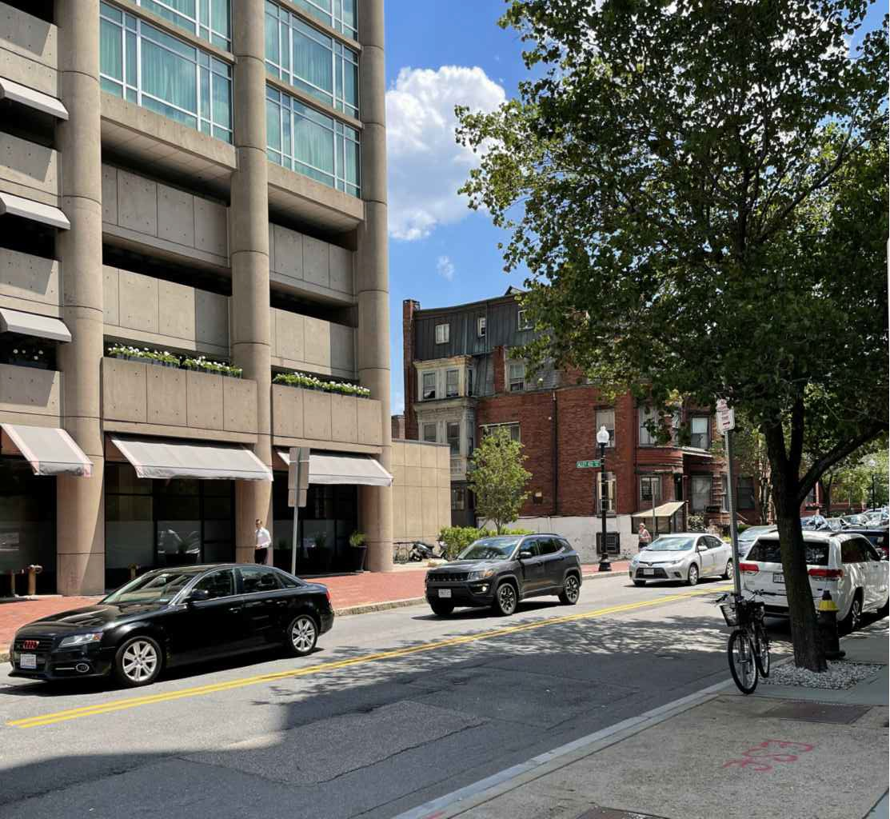
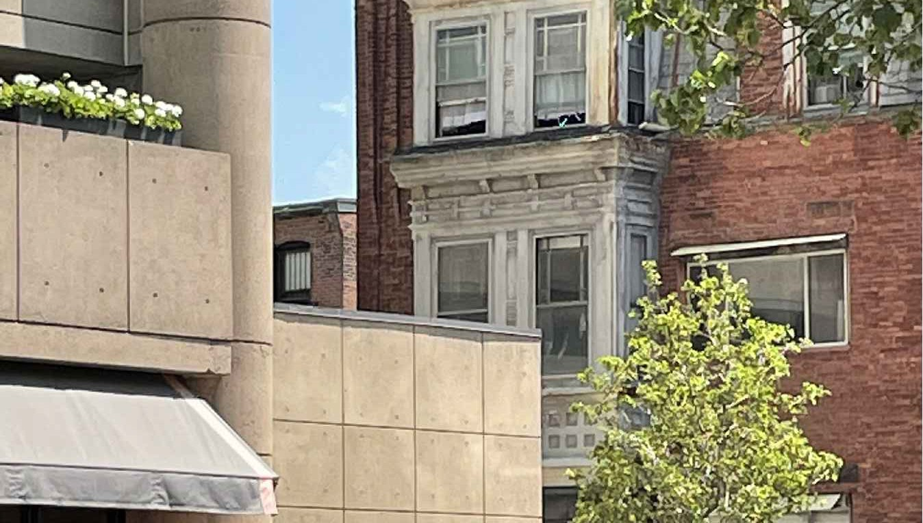
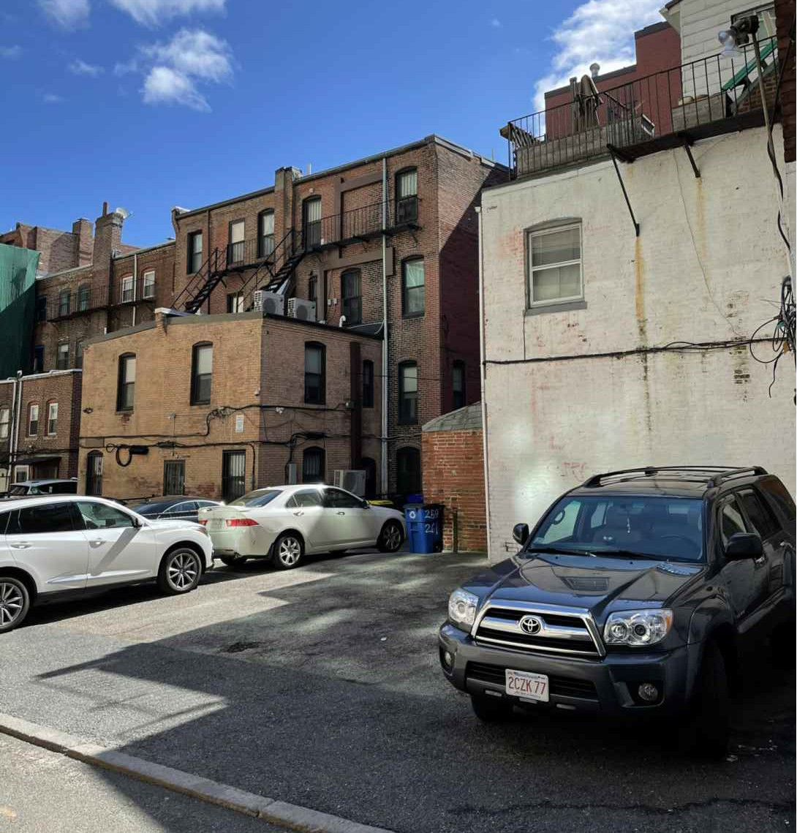
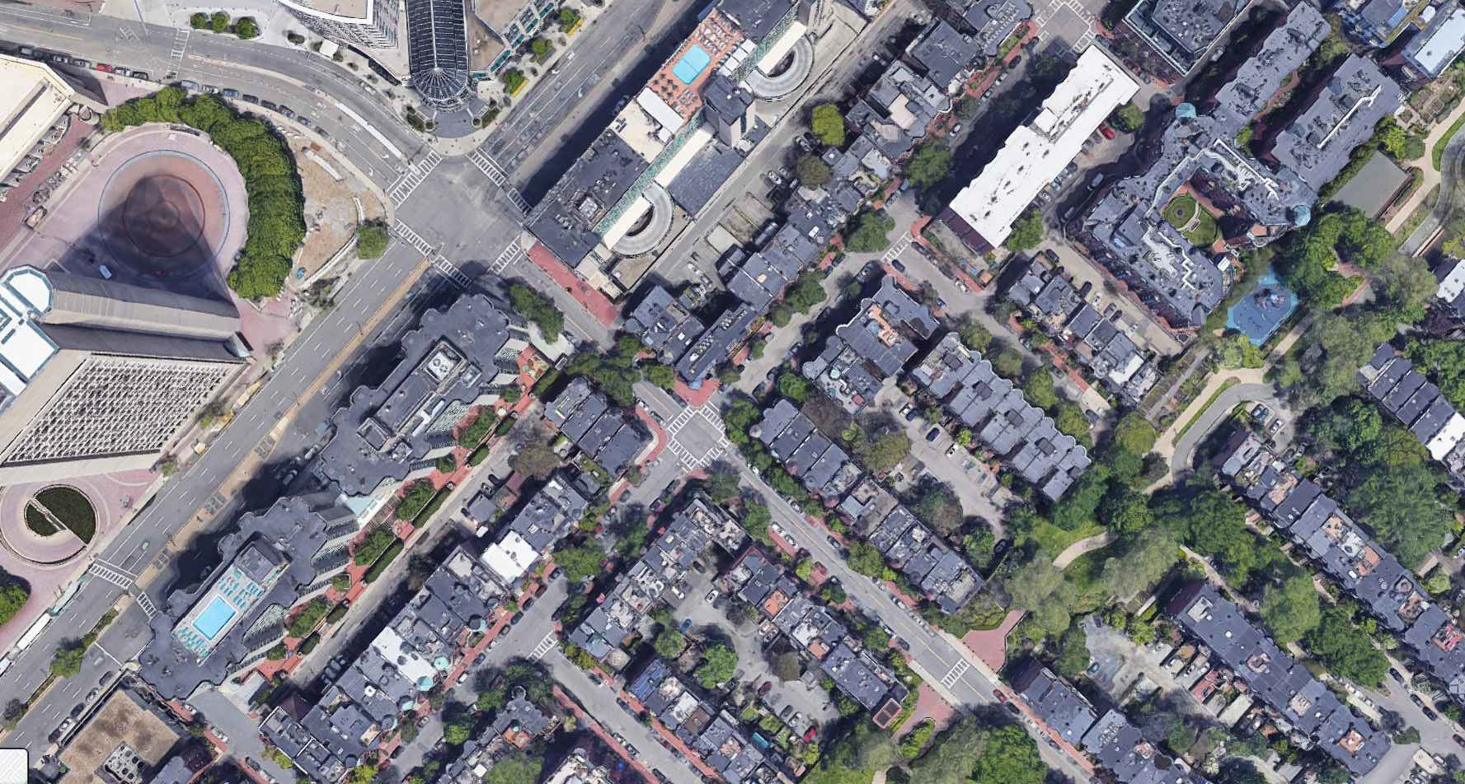
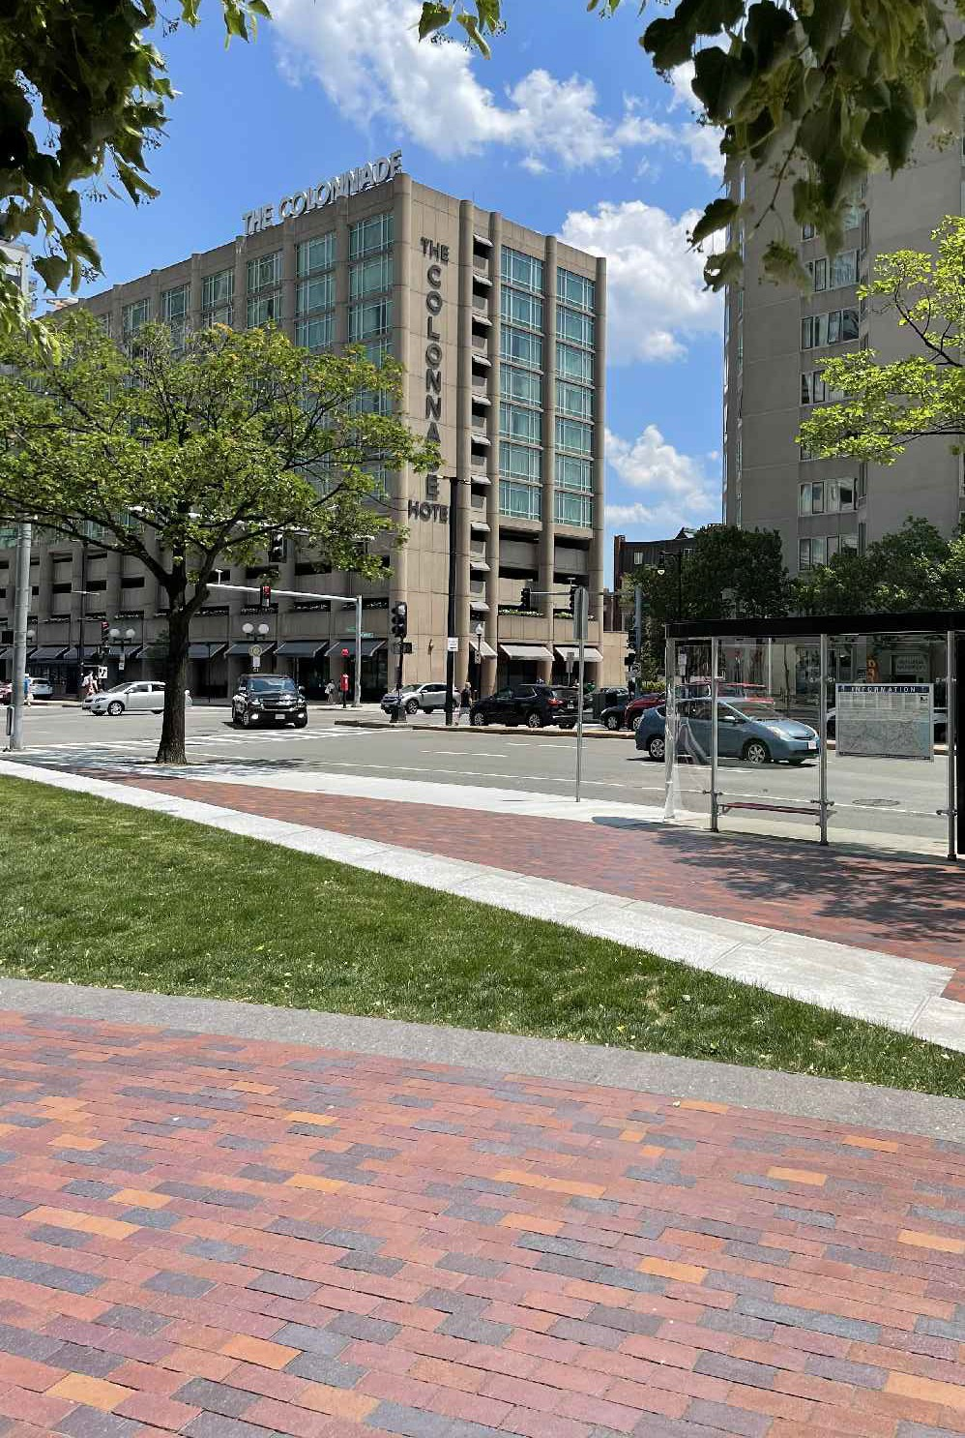

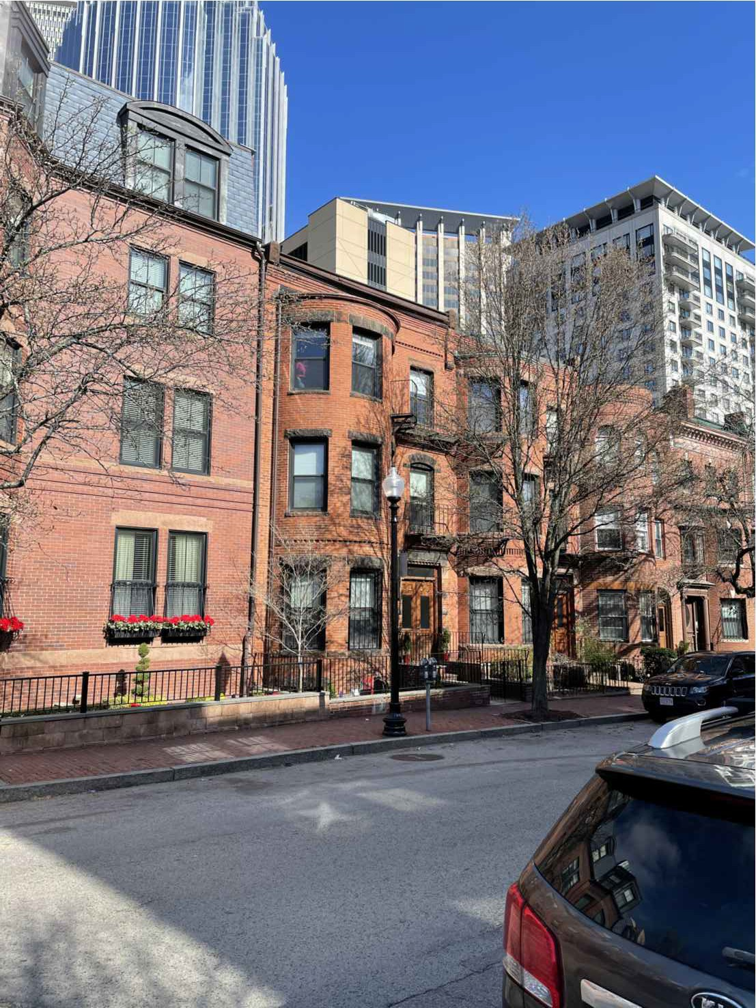

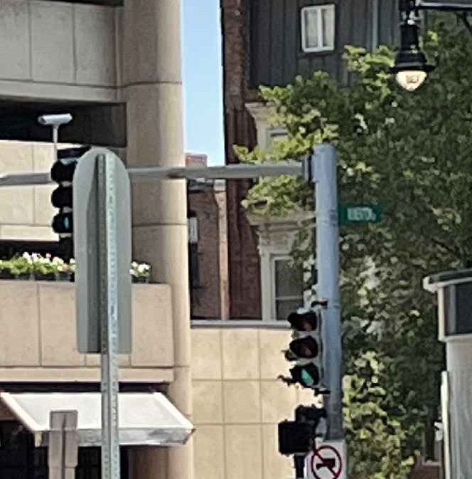

PROPOSED ROOF DECK UNIT 3
95 ST BOTOLPH ST BOSTON, MASS
VIEW FROM HUNTINGTON/
1 W NEWTON CORNER CLOSE UP
VIEW FROM HUNTINGTON/ 1 W NEWTON CORNER
FROM THE WEST
HUNTINGTON AVE
PA 402
VIEW FROM PA402 3 FROM THE WEST
1
ST BOTOLPH ST
Choo
2
3
&Company, Inc.
One Billings Road Quincy, MA 02171
617-786-7727 fax 617-786-7715
4
W NEWTON ST
□
 
 □

2021098
AS NOTED
04-14-2021
SL

 
 
PROPOSED SITE CONTEXT
VIEW FROM CSC PLAZA FROM THE WEST
2
 □

VIEW FROM ST BOTOLPH FROM THE SOUTH
4
VIEW FROM CSC PLAZA
CLOSE UP
2

Slide 4
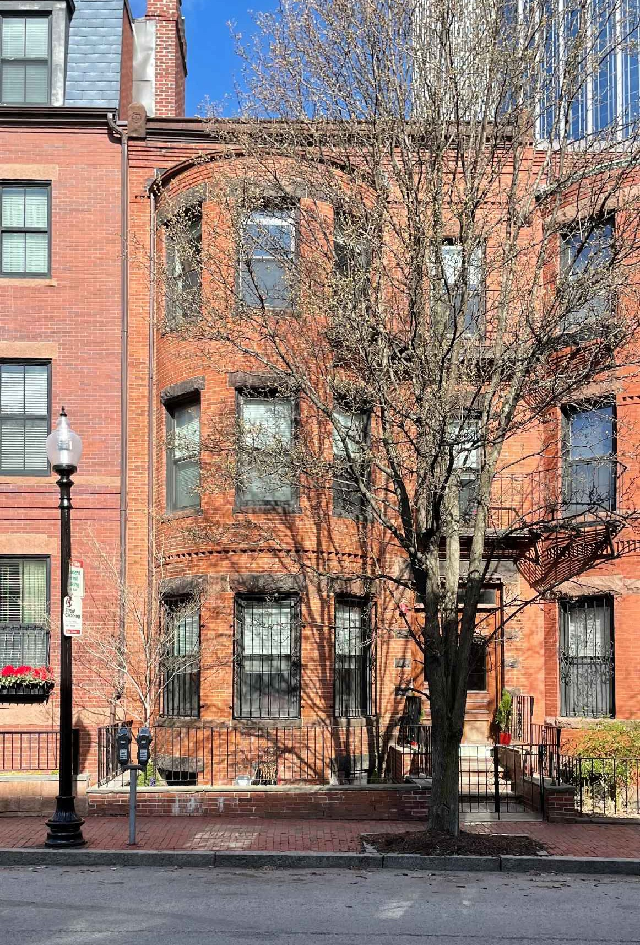
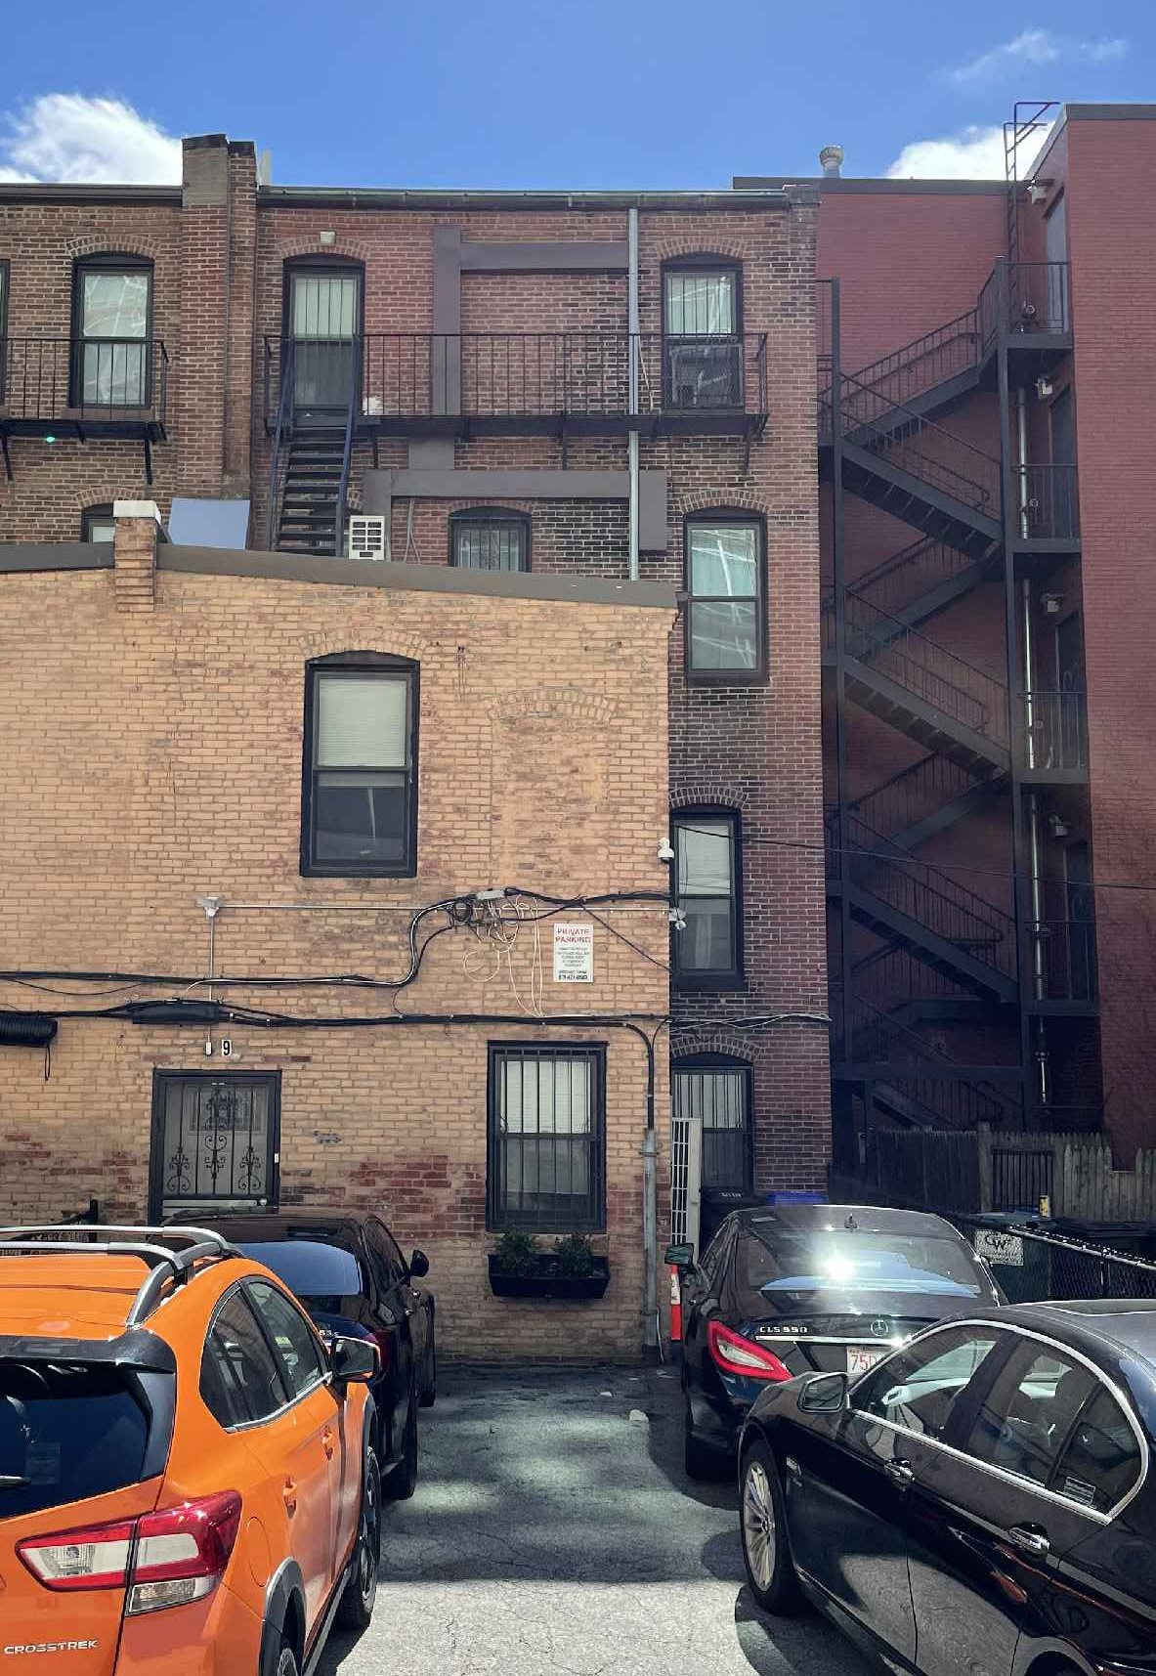
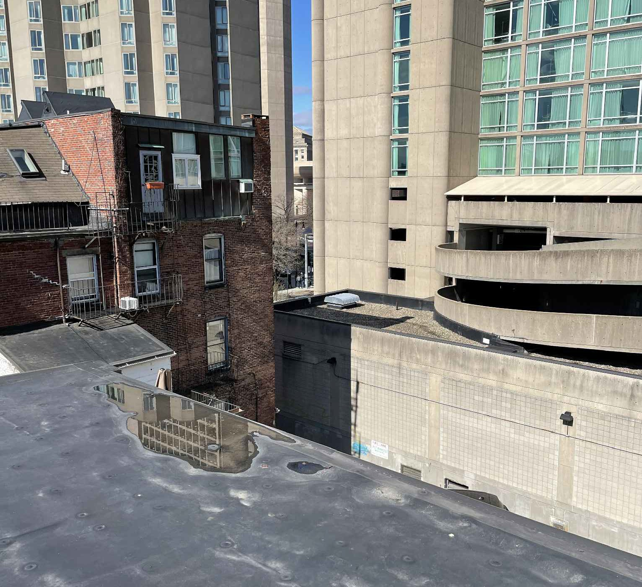
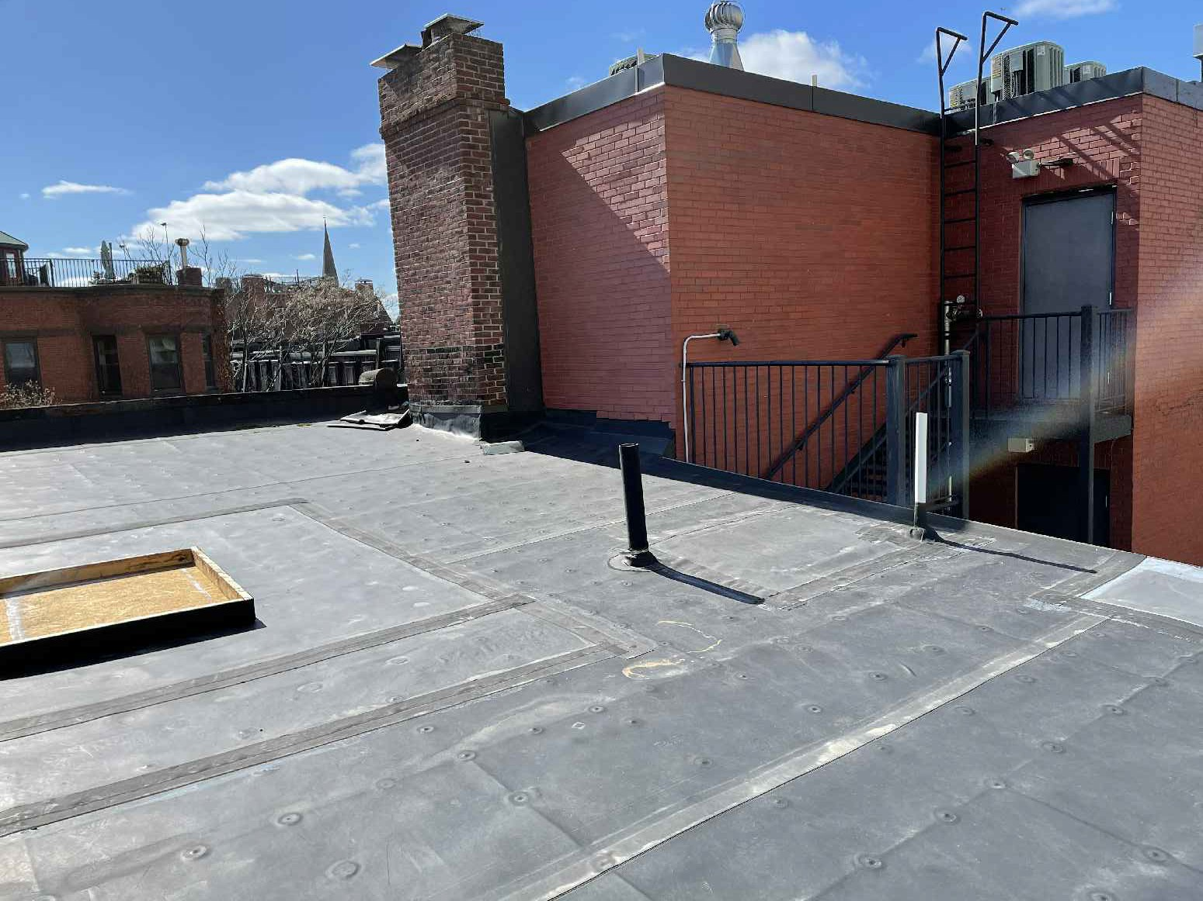
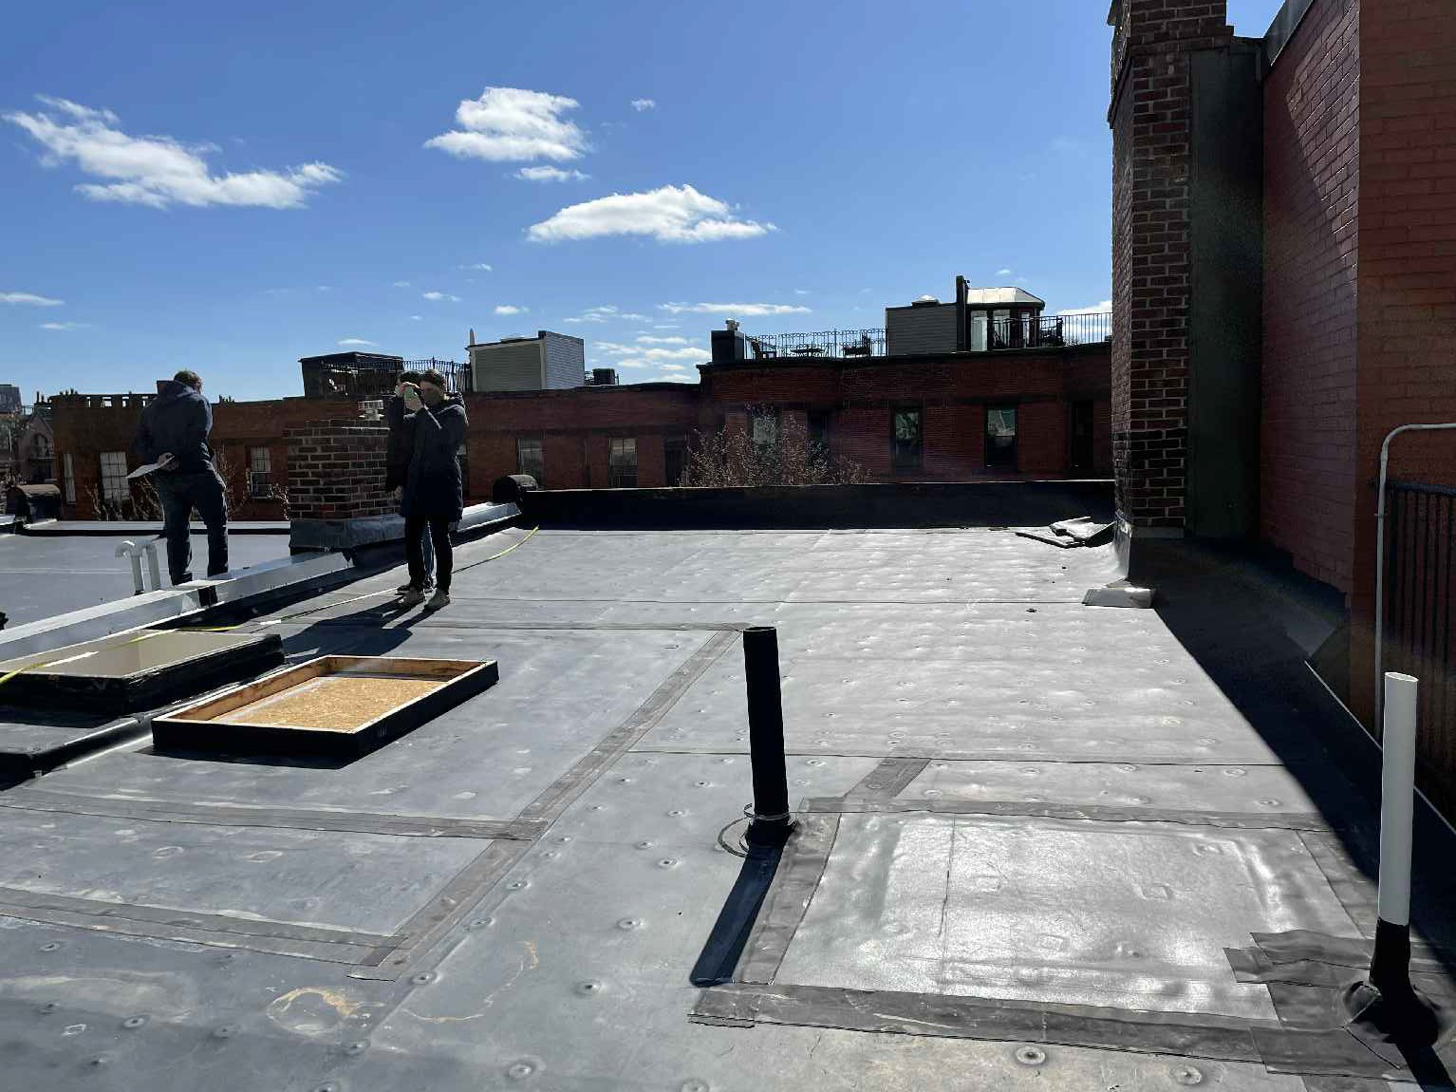
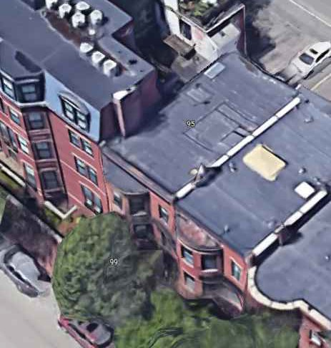

PROPOSED ROOF DECK UNIT 3
95 ST BOTOLPH ST BOSTON, MASS
C
hoo
&Company, Inc.
VIEW FROM CORNER OF ROOF LOOKING BACK TOWARD CSC PLAZA (HUNTINGTON VISIBLE)
One Billings Road Quincy, MA 02171
617-786-7727 fax 617-786-7715
95 ST BOTOLPH FRONT ELEVATION
95 ST BOTOLPH REAR ELEVATION
□
 
 □

2021098
AS NOTED
04-14-2021
SL

 
 
PROPOSED SITE CONTEXT
 □

EXISTING ROOF LOOKING SOUTH TOWARDS 99 ST BOTOLPH HOTEL
EXISTING ROOF LOOKING SOUTHEAST TOWARDS ST BOTOLPH STREET
EXISTING ROOF FROM THE EAST

Slide 5



PA 402
PA 402
PA 402
PROPOSED ROOF DECK UNIT 3
95 ST BOTOLPH ST BOSTON, MASS
FIRE ESCAPE
10'-0" ±
CL
6'-0" ±
NEW RUBBER ROOF
11'-11" ±
BEDROOM
BATH
10'-2" ±
ROOF SLOPE
DN
W/D
42" BLACK
UP
STEEL
CL
RAILING
8'-10" ±
EXG STAIR
DN
18'-0" ±
PROPOSED ROOF DECK
-EXCLUSIVE TO UNIT 3
KITCHEN
PROPOSED HATCH
C
hoo
UNIT 3
EX'G HATCH
2'-6" ±
15'-0" ±
3'-8" ±
&Company, Inc.
26'-2" ±
CL
3'-7" ±
One Billings Road Quincy, MA 02171
617-786-7727 fax 617-786-7715
EX'G STAIR UP
LIVINGROOM
11'-6" ±
NEW RUBBER ROOF
ROOF SLOPE
DN
14'-3" ±
ROOF SLOPE
DN
19'-10" ±
EX'G CHIMNEY
EX'G CHIMNEY
EX'G CHIMNEY
EX'G CHIMNEY
□
 
 □

2021098
AS NOTED
04-14-2021
SL
ST BOTOLPH STREET
ST BOTOLPH STREET
  
  
ST BOTOLPH STREET
  

 

     
  


  
 
PROPOSED FLOOR PLANS
 □


Slide 6

PROPOSED ROOF DECK UNIT 3
95 ST BOTOLPH ST BOSTON, MASS
42" BLACK STEEL
RAILING
PROPOSED ROOF DECK
PROPOSED ROOF
HATCH
ROOF
ROOF DECK
ROOF
12'-8" ±
12'-8" ±
C
hoo
&Com
pany, Inc.
3rd FLOOR
LINE OF SITE
3rd FLOOR
One Billings Road Quincy, MA 02171
617-786-7727 fax 617-786-7715
36'-3" ±
10'-4" ±
36'-5" ±
36'-3" ±
10'-4" ±
2nd FLOOR
2nd FLOOR
□
 
10'-9" ±
10'-9" ±
1st FLOOR
1st FLOOR
 □

2021098
AS NOTED
04-14-2021
SL
2'-6" ±
2'-6" ±

 

  
  

  
  
 
PROPOSED ELEVATIONS
 □


Slide 7
ROOF DECK
ROOF
12'-8" ±
3rd FLOOR
10'-4" ±
43'-4" ±
43'-2" ±
2nd FLOOR
10'-9" ±
1st FLOOR
9'-5" ±
BASEMENT

Slide 8




42" BLACK STEEL
18'-0" ±
HANDRAIL
PROPOSED ROOF DECK UNIT 3
95 ST BOTOLPH ST BOSTON, MASS
12'-4" ±
RAILING
PROPOSED ROOF DECK
PROPOSED ROOF HATCH FOR ROOF ACCESS W/ PNEUMATIC LIFT SYSTEM
12" MAX ABOVE EX'G ROOF
2" PROPOSED
30" MAX
PROPOSED ROOF HATCH
WOOD TRIM PAINTED BLACK 10'-2" ±
ROOF DECK
6'-0" ±
ROOF
EX'G SLOPE BELOW 5%
4.27° ±
¹².9"
12'-8" ±
LINE OF EX'G
PROPOSED STAIR EXTENSION TO ROOF DECK
EX'G ROOF HATCH
EX'G ROOF LINE
EX'G GYP BOARD WALL
CEILING
UNIT 3
LINE OF SITE
3rd FLOOR
NEW HANDRAIL EXISTING STAIR TO ROOF
36'-5" ±
36'-3" ±
10'-4" ±
LINE OF SITE
UNIT 2
2nd FLOOR
10'-9" ±
Choo
1st FLOOR
&Company, Inc.
ST BOTOLPH STREET
2'-6" ±
One Billings Road Quincy, MA 02171
617-786-7727 fax 617-786-7715
50'-0" ±
PA 40

 
  
□
 
LINE OF SITE
 □

2021098
AS NOTED
04-14-2021
SL

 
 
PROPOSED ELEVATIONS
PA 402
 □


