Slide 1
31 Charles St Awning Replacement Request

Slide 2
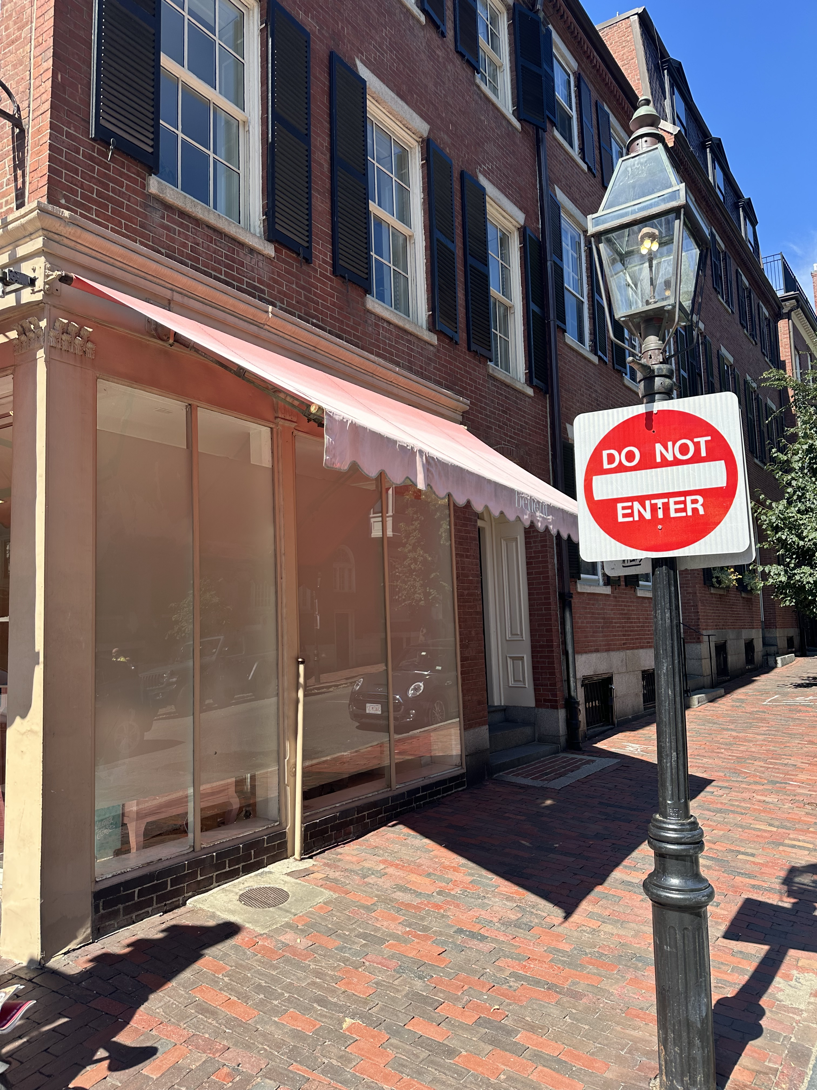
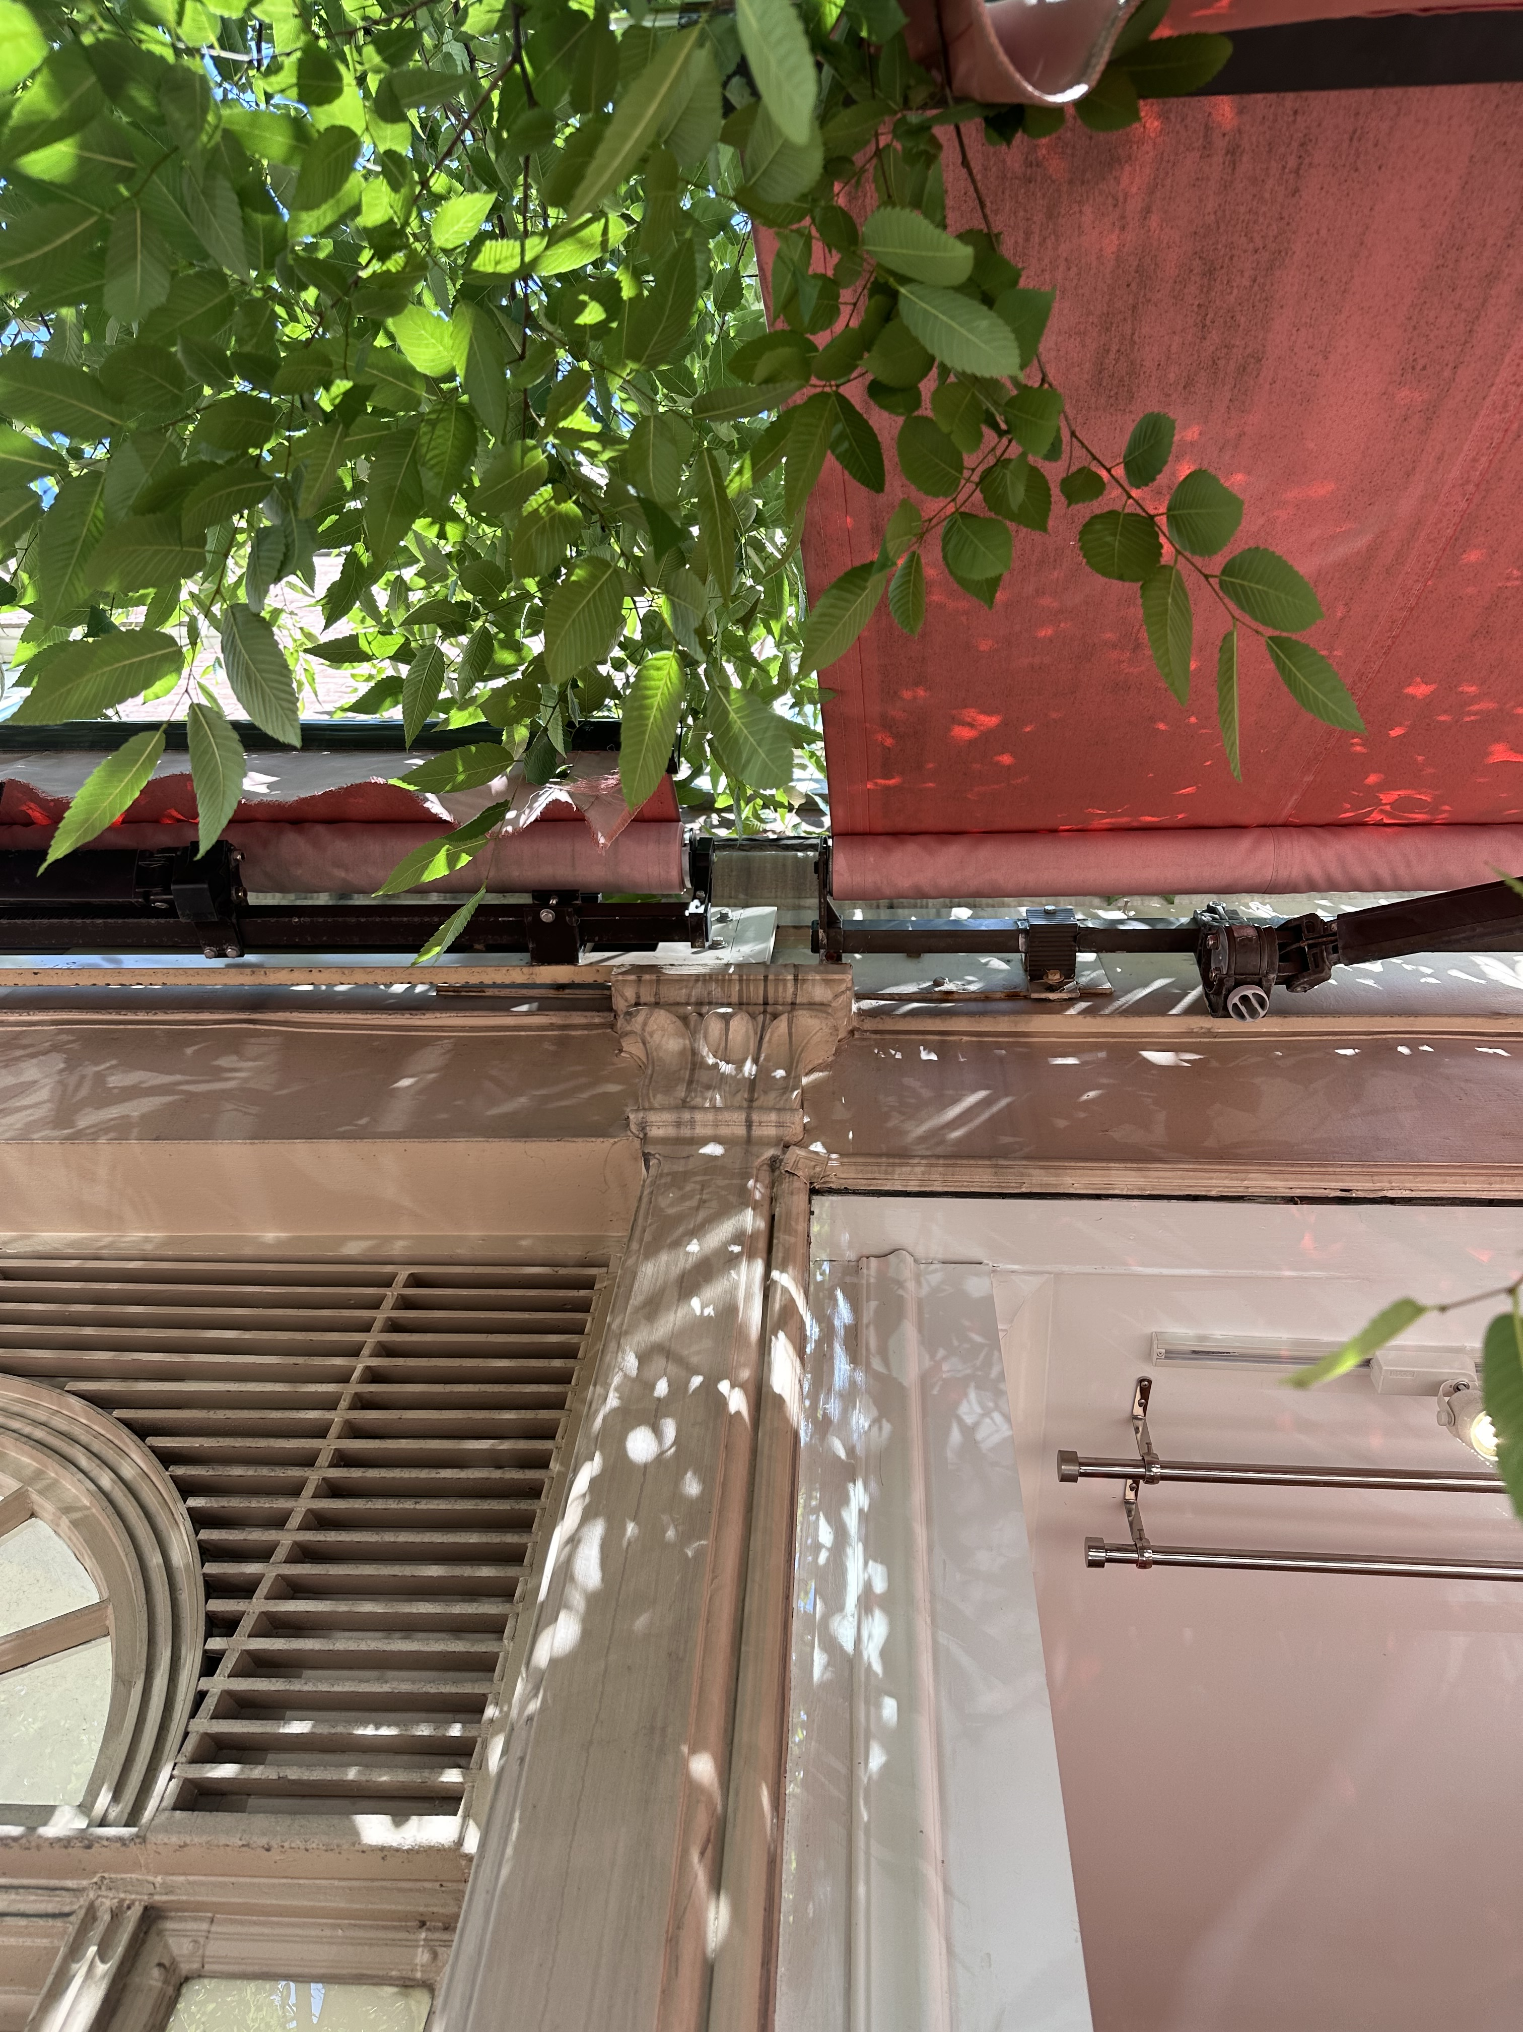
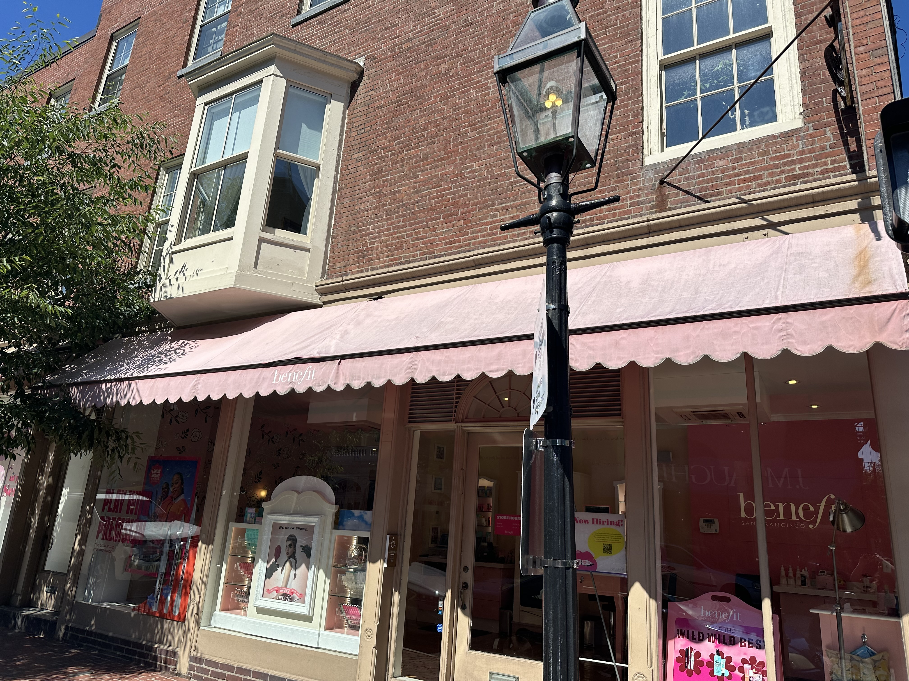
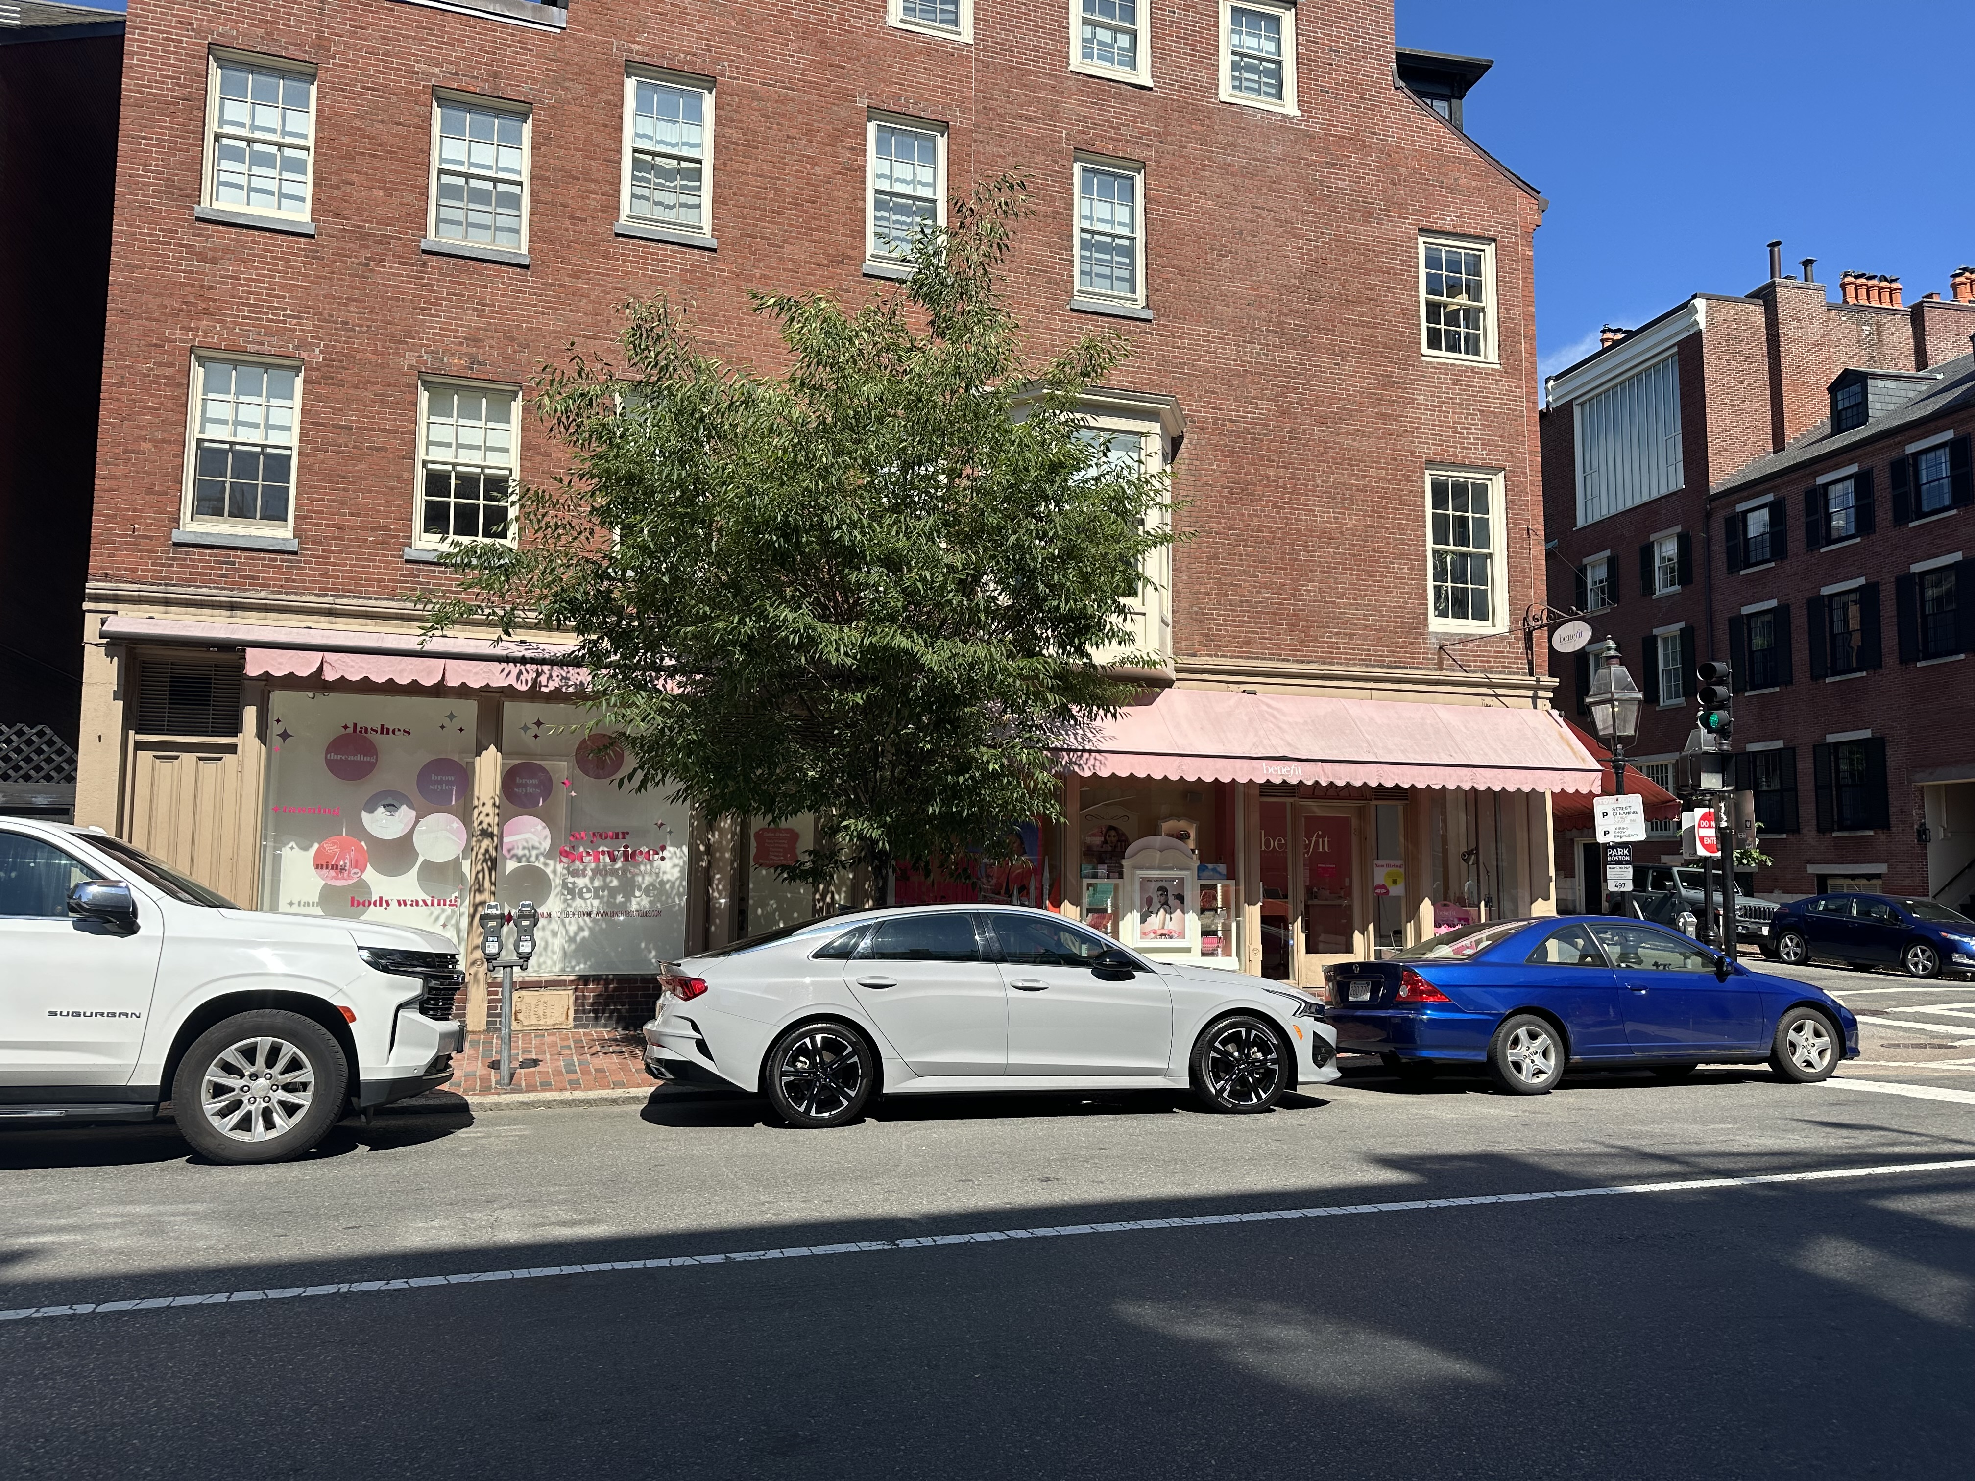
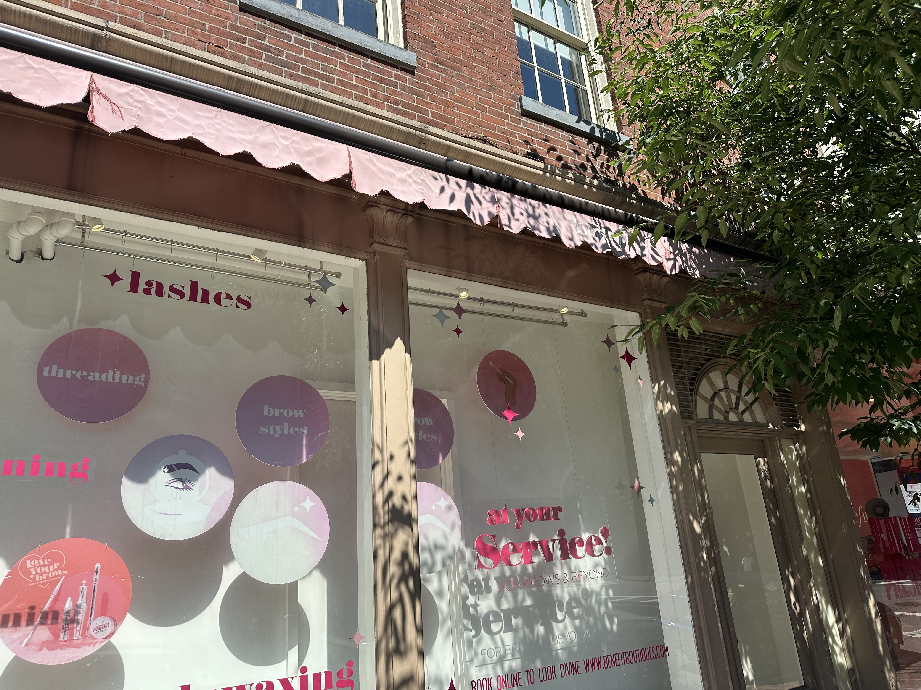
Existing Photos

Slide 3
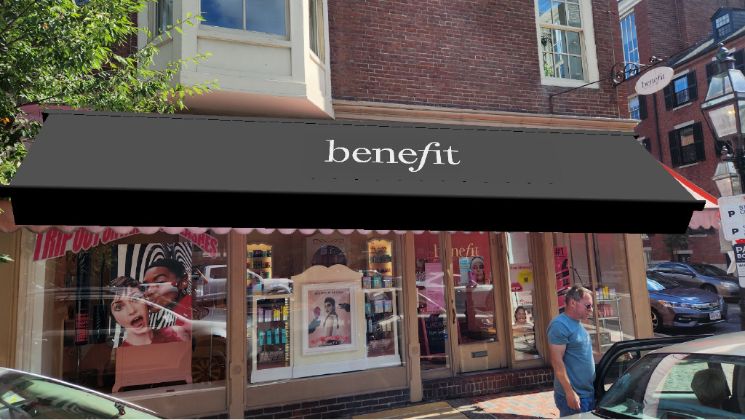
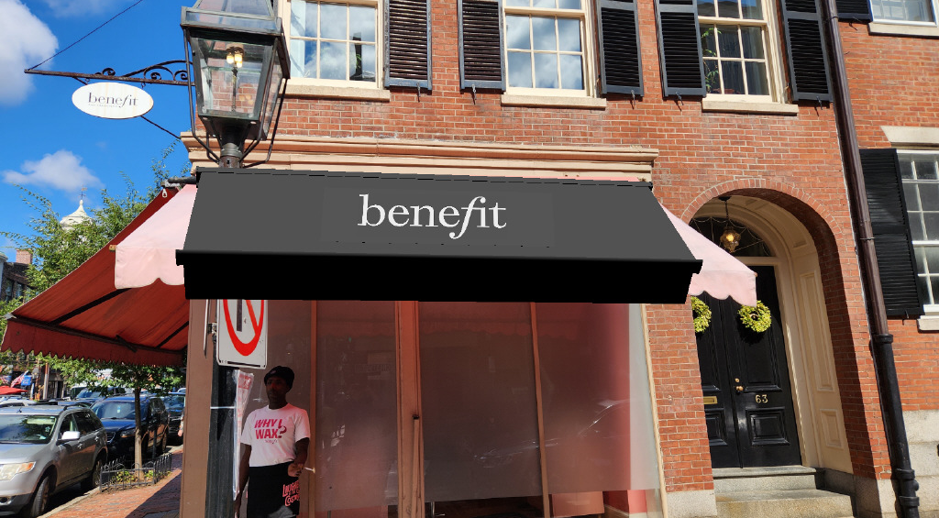
Proposed Awning

Slide 4
Three total awnings
Using existing hardware
Pink → Black
Old, smaller logo → New logo on top; easier to see
Material: Tempotest, which is equivalent to Sunbrella

Slide 5
Thank you

