Slide 1
Reparations Task Force
December 16, 2024 Public Meeting

Slide 2
AGENDA
Call to Order
Opening remarks
Grantees projects update
Progress report for Researchers (Tufts and Northeastern)
Public Comments
Update for Next Meeting
Adjournment

Slide 3
Call to Order + Roll Call
Chair Joseph D. Feaster Jr.

Slide 4
Opening Remarks
Chair Joseph Feaster, Chief Solis Cervera

Slide 5
Grantees Projects Update
Khalid Mustafa

Slide 6
Researchers Progress Report
Tufts University

Slide 7
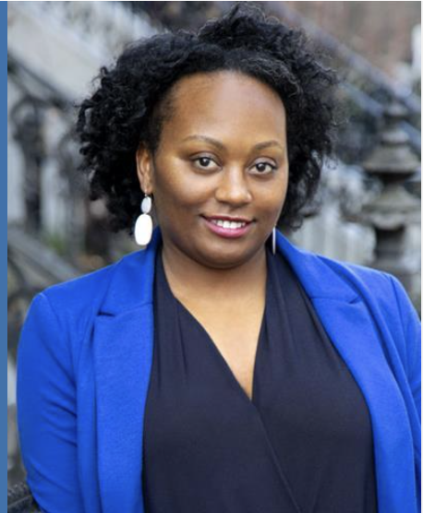
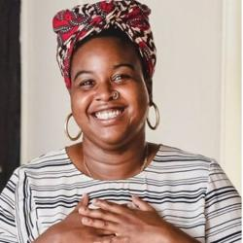
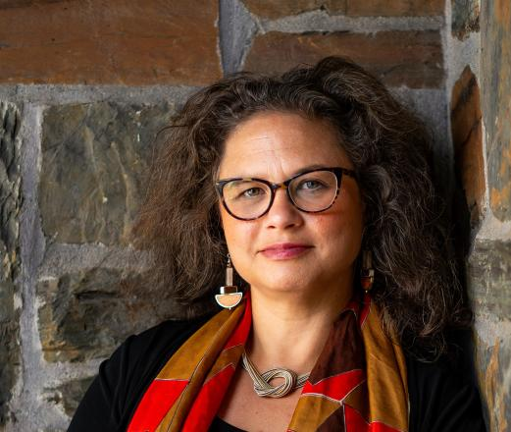
City of Boston / History and Legacy of Slavery
Research Team (1620-1940)
Kyera Singleton
Royall House and Slave Quarters
Commissioner, Boston
City Commemoration Commission
Kerri Greenidge, Ph.D.
Tufts University
Kendra Field, Ph.D.
Tufts University

Slide 8
Key Approaches and Methodologies
Mapping people and places
Names and stories of enslaved individuals and families
Property ownership of enslavers, their families, institutions
Attention to shifting geographies and migration patterns within the history of Boston.
Focus on the impact of laws and policies on the everyday lives of enslaved people and their descendants.
Incorporating historical and genealogical methods and descendant communities.

Slide 9
Researchers Progress Report
Northeastern University

Slide 10
SLAVERY AND ITS LEGACY: BOSTON, 1940-2020
NORTHEASTERN UNIVERSITY
Research Partners: EVOOO13090
December, 2024

Slide 11
Primary Organizations
SLAVERY AND ITS LEGACY: BOSTON, 1940-2020
NORTHEASTERN UNIVERSITY
CONTACT INFORMATION
Deborah A. Jackson
Managing Director, Center for Law, Equity and Race
360 Huntington Avenue, 140 DK, Boston, MA 02115
de.jackson@northeastern.edu
617-373-4066
Archives and Special Collections
Notes:
Is there a clearer logo for the Reckoning Project?

Slide 12
Topics
THREE PRIMARY TOPICS:
EDUCATION
BOSTON POLICE AND FIRE DEPARTMENTS
HOUSING AND URBAN RENEWAL
THREE SUB-AREAS:
SLAVERY AND ITS LEGACY: BOSTON, 1940-2020
NORTHEASTERN UNIVERSITY
DISPARITIES IN TREATMENT IN THE CRIMINAL JUSTICE SYSTEM
HEALTH DISPARITIES
PROCUREMENT POLICIES AND PRACTICES
Notes:
It might be better to list the six topics under the guidance heading and place the three areas of focus in a different box.

Slide 13
EQUAL QUALITY EDUCATION
Impact of 1965 adoption of Racial Imbalance Act and City’s refusal to implement the Act
Racist responses to Morgan v. Hennigan (1974) by public officials
Documentation of City failure or policies to:
Address effects and harms of anti-busing opposition, 1974-1983
Enact policies to prevent resegregation of public schools, 1983-1992
Disadvantaging Black teachers and administrators for promotion or discipline
Racially discriminatory disciplinary practices
Discrimination in operation of exam schools
Measuring racially differential outcomes
SLAVERY AND ITS LEGACY: BOSTON, 1940-2020
NORTHEASTERN UNIVERSITY
Education
TEAM MEMBERS RESPONSIBLE FOR THIS RESEARCH...
ZEBULON MILETSKY,
STONY BROOK UNIVERSITY
DONNA BIVENS,
INDEPENDENT CONSULTANT

Slide 14
EMPLOYMENT DISCRIMINATION
Racially exclusionary hiring, 1940-1970
Legal and other challenges:
Discriminatory practices leading to Castro v. Beecher, 1971
Police entrance exams challenged as not job-related
City’s role in failing to implement consent decree
Assaults on Black officers by white colleagues – e.g., Cox case; City fails to protect
Discrimination at the Academy; threatened boycott of graduation, 1979
Discriminatory Effects of Proposition 2 ½
Discriminatory Use of Hair Test for Drugs, Jones v. City of Boston, 2014
Discriminatory Promotion exam for lieutenants; Smith v. City of Boston, 2015
Discriminatory Assignment and disciplinary practices
Discriminatory Exam for Promotion to Sergeant, Lopez v. Lawrence
Lost Ground with release from Consent Decree under Deleo v. City of Boston, 2004
SLAVERY AND ITS LEGACY: BOSTON, 1940-2020
NORTHEASTERN UNIVERSITY
Boston Police Department

Slide 15
EMPLOYMENT DISCRIMINATION
Racially exclusionary hiring, 1940-1970
Discrimination in BFD as addressed in NAACP v. Beecher, 1972, and rejection of racially discriminatory entry exams
Entry-level employment in BFD
City’s role in failing fully to implement Beecher consent decree
Racially discriminatory effects of Proposition 2 ½ on BFD hiring
On the job harassment
Disparate assignments
Discriminatory promotion practices
Discriminatory disciplinary practice
Consent decree vacated, Quinn v. Boston, 2003
SLAVERY AND ITS LEGACY: BOSTON, 1940-2020
NORTHEASTERN UNIVERSITY
Boston Fire Department

Slide 16
HOUSING DISCRIMINATION
PUBLIC HOUSING/BOSTON HOUSING AUTHORITY
Exclusion of Black families from housing in South Boston, Charlestown, and East Boston
Concentration of Black families in Columbia Point, a formerly integrated housing project
Voucher system administered in racially discriminatory manner
Concentrating Section 8 voucher holders in Roxbury, Dorchester and Mattapan
Discriminating against families with children
NAACP v. HUD, 1978, challenges HUD and BHA practices; Ct. finds violations of Fair Housing Act, including racially discriminatory disbursement of federal housing funds
Found BHA policy to maintain racial discrimination in housing assignment
1989 decree in NAACP v. Kemp – fair housing funding, monitoring and reporting
Discrimination in Mortgage Lending, 2015 data, and in Rental Market
SLAVERY AND ITS LEGACY: BOSTON, 1940-2020
NORTHEASTERN UNIVERSITY
Housing and Urban Renewal

Slide 17
URBAN RENEWAL
PRIVATE HOUSING MARKET/URBAN RENEWAL
Restrictive Covenants and Racialized Zoning Practices, 1940s-1950s
Urban Renewal and Federal Housing Policies – 1950s
Demolition: the “New York” streets, West End, Roxbury, Dorchester, Charlestown, East Boston
Redlining, 1940s-1968 - FHA refusal to insure mortgages in predominantly Black neighborhoods
Displacement of Black community in South End
Boston Banks Urban Renewal Group (“BBURG”), redlining loans to racially reconfigure communities in Roxbury, Dorchester and Mattapan, 1963
SLAVERY AND ITS LEGACY: BOSTON, 1940-2020
NORTHEASTERN UNIVERSITY
Housing and Urban Renewal
RESULTS: <90% BLACK AND LATINO HOUSEHOLDS HOUSED IN LOWEST OPPORTUNITY NEIGHBORHOODS IN BOSTON

Slide 18
DISPARITIES IN TREATMENT IN THE CRIMINAL JUSTICE SYSTEM
Policing Agencies in Boston
BPD, BHA Police; Boston Municipal Protective Services; Boston Park Rangers, Boston Public Health Commission Police
Over- and Under-Policing in Black Neighborhoods
Oversurveillance in Black Neighborhoods
Discriminatory Search and Seizure Practices
Implementation of “Search on Sight” Policy, condemned in Commonwealth v. Phillips, 1992
Disparate traffic stops in Black neighborhoods
Failure to Prevent or Punish Police Misconduct and Brutality
Stuart Case, 1989
Levi Hart killing, 1980
St. Clair Commission Report, 1992
Failure to Train, Leading to Wrongful Convictions
Discriminatory School Discipline – “school to prison pipeline”
SLAVERY AND ITS LEGACY: BOSTON, 1940-2020
NORTHEASTERN UNIVERSITY
Criminal Justice and Police Practices

Slide 19
RACE-BASED INEQUALITIES IN HEALTH CARE
Framework: Social Determinants of Health
Discrimination against Black providers by their peers, institutions, and patients
Deleterious Effects on Health of Discriminatory Treatment
Residential Segregation
School Segregation, substandard education
Racialized Policing
Discriminatory Employment Practices and Poor Working Conditions
Health effects of exposure to violence, including gun violence
Exposure to Environmental Hazards
Inadequate services from Public Works
Poor air quality
SLAVERY AND ITS LEGACY: BOSTON, 1940-2020
NORTHEASTERN UNIVERSITY
Health Disparities

Slide 20
PROCUREMENT
1978: Minority Business Enterprises Program established to address exclusion from contracting opportunities with 10% set-aside requirement
1987: 15% set-aside requirement; Women-owned businesses included with 5% requirement
2003: Targeted program ended in 2003 with shift to race-neutral Small and Local Business Enterprise (SLBE) program
Reduction in percentage of contracts awarded
2017: Ordinance on Equity in City Contracts adopted
2020 study: Continuing underutilization of MBEs
– about 1.2% of $2.1B city contracts benefitted Black and Latinx-owned companies
SLAVERY AND ITS LEGACY: BOSTON, 1940-2020
NORTHEASTERN UNIVERSITY
Procurement Policies and Practices

Slide 21
THE HARMS
Housing Disparities and Residential Segregation
Inequities in Educational Opportunities
Ongoing segregation
Disparities in School performance and access to higher education
Exposure to criminal legal system
Criminal Legal System
Over-criminalization and Over-Policing
Disproportionate Imprisonment
Impact on incarcerated persons and families
Economic Impacts
Wealth Inequality
Diminished Employment Opportunities
Long-term income disparities
Health Inequities
Physical and mental disparities
Reduced life expectancy
Inadequate access to healthcare and health insurance
Traumatic and Stress effects of systemic, repeated exclusion
SLAVERY AND ITS LEGACY: BOSTON, 1940-2020
NORTHEASTERN UNIVERSITY
The Harms

Slide 22
Project Timeline
JUNE - AUGUST
OCTOBER - NOVEMBER
Drafting and Completing Literature Review
Research and Report Drafting
SLAVERY AND ITS LEGACY: BOSTON, 1940-2020
NORTHEASTERN UNIVERSITY
SEPTEMBER
DECEMBER - JANUARY
Research Outlines
Final Report

Slide 23
THANK YOU.
SLAVERY AND ITS LEGACY: BOSTON, 1940-2020, NORTHEASTERN UNIVERSITY

Slide 24
Public Comments
Joseph D. Feaster Jr.

Slide 25
General Public Comments
We will now open the floor and the Zoom chat for questions and comments.
Please keep your comment limited to 2 minutes or less. We will time comments.

Slide 26
Update for Next Meeting
Joseph D. Feaster Jr.

Slide 27
Adjournment
Joseph D. Feaster Jr.

