Slide 1
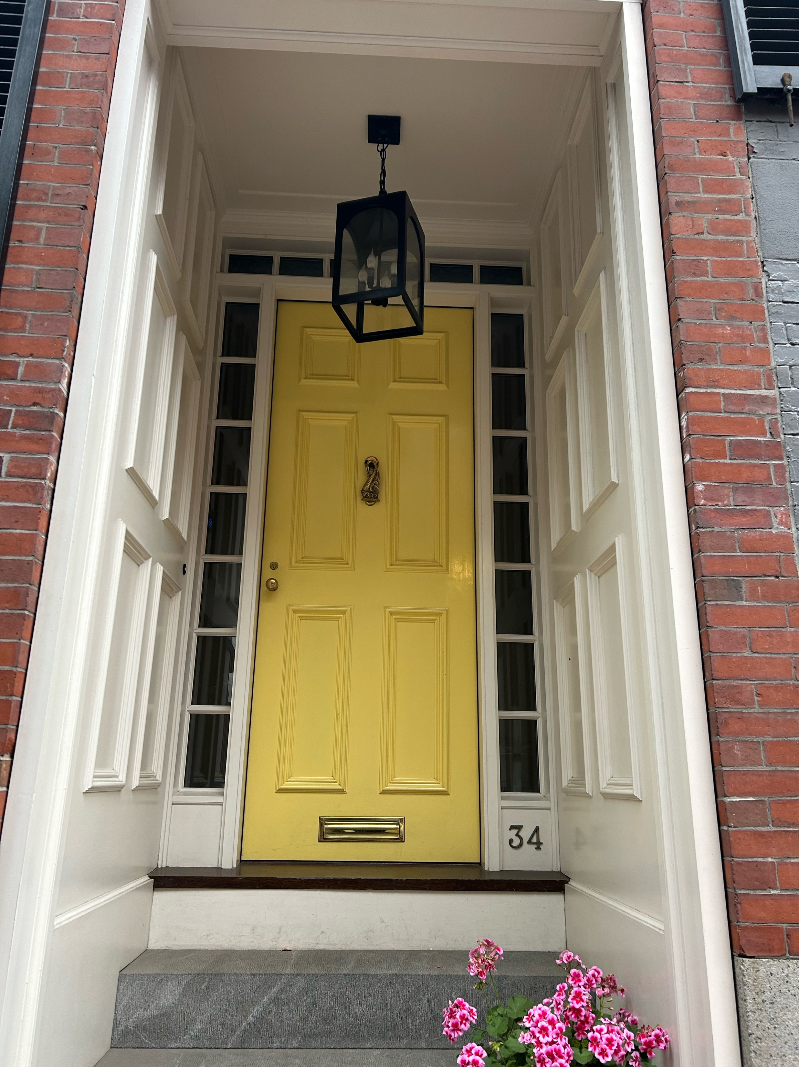


34 W CEDAR STREET – PRESENTATION – August 2025
Repaint In Kind:
Entry: existing Benjamin Moore Swiss Coffee OC-45 semi-gloss
Door: existing Benjamin Moore 319 Dalila high gloss
Proposed Change:
Paint entry ceiling in Benjamin Moore Wythe Blue HC-143 in semi-gloss

