Slide 1
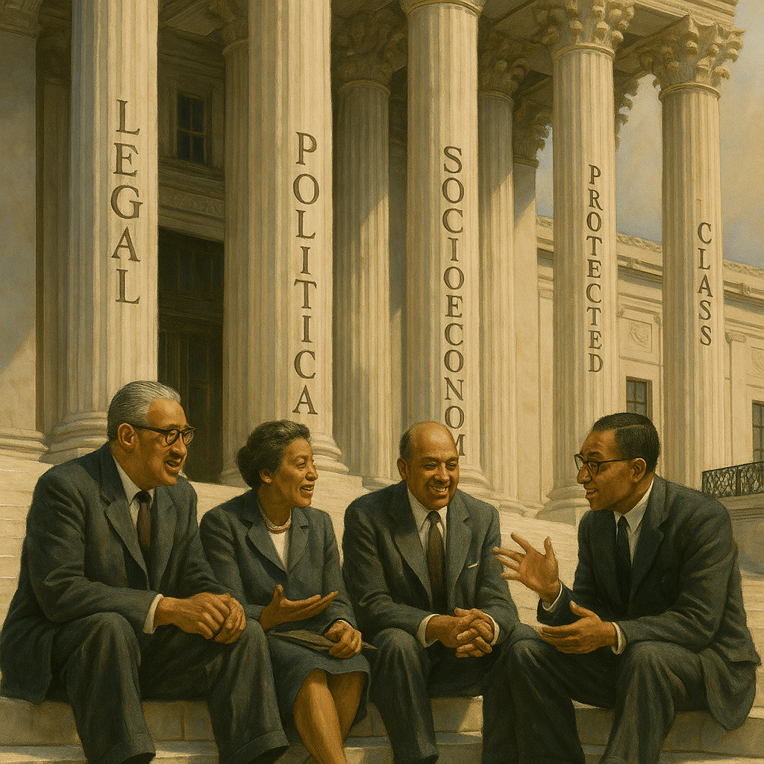


The 4 Pillars of Freedmen Status: A Legal and Moral Framework for Justice in Boston
Reframing Reparations Around Status, Not Race
Presented by: Josh Gray For the Boston Reparations Task Force — Juneteenth, 2025
by Josh Gray
Notes:
Speaker Notes: Hook (15 sec) – Display a split‑screen graphic: left shows $8 (net‑worth figure) and right shows $247,500. “This is the median wealth gap between Freedmen and white households right here in Boston. My goal today is to show you not only why that gap exists, but how we can close it — without violating the Constitution.”
• Story anchor – 30‑sec snapshot: “Many of us have family members. That policy decision shows up in that $8 today.”
• Plain‑language sidebar – “We’ll talk law, but I promise plain English. Anytime you hear a legal term, I’ll translate it in ten words or less.”
• Micro‑interaction – Show of hands: Who has ever read the 13th Amendment? Use to preview later content.
Transition – “Here’s the roadmap for the next 20 minutes — seven quick sections that build from a single question: What does ‘status’ really mean?”

Slide 2
Today's Roadmap
What is "status" and how is it used outside the Freedmen context?
What is Freedmen status, and why does it matter?
How does it differ from race or ancestry?
The four pillars of Freedmen status:
Legal
Political
Socioeconomic
Protected class potential
Historical and legal precedent
What this means for Boston
Call to action & audience Q&A
Notes:
Speaker Notes: Hook (10 sec) – Live word cloud (Mentimeter): ask audience to type one word they associate with status. Display results in real time.
• Highlight the highest‑frequency words and segue: “Interesting that wealth and power popped up largest — that’s exactly what status controls.”
• Plain‑language promise – “I’ll translate every statute into a headline you could tweet.”
• Engagement cue – “Look for the green QR codes in corners — scan them anytime to vote on live polls.”
This is our roadmap for today. We'll begin with a foundational question — what does status mean in American law and policy? From there, we'll apply that framework to Freedmen, the class of people created by emancipation. We'll move through each of the four status types and connect them directly to the legal and constitutional case for reparations, including how current efforts in Boston like H.1696 and HD.3879 can align with this framework.
Transition – “Let’s quickly unpack what lawyers mean by ‘status’ before we layer in the Freedmen context.”

Slide 3
Understanding "Status" in Law and Society
Type of Status
Definition & Examples
Legal Status
A category that defines rights, obligations, or restrictions under the law. 📌 Examples: Refugee, undocumented immigrant, felon, married person (1)
Political Status
A person's relationship to a state or governing authority. 📌 Examples: Citizen, non-citizen, stateless person, member of a tribal nation (2)
Socioeconomic Status
A person's standing in the social and economic hierarchy. 📌 Examples: Working class, low-income, affluent, elite (3)
Protected Class Status
A group shielded from discrimination by law due to historical or structural disadvantage. 📌 Examples: Disability status, veteran status, religious affiliation, pregnancy (4)
Notes:
Speaker Notes: Hook (10 sec) – “Think of status like an ID badge. It can open doors—or slam them. Let’s see which badges most of us wear without realizing it.”
• Interactive moment – Invite audience to shout which status from the table they think affects them today (marital, tax, etc.).
• Plain‑language sidebar – “Protected class just means the law owes you extra shielding because history hasn’t been fair.”
• Connect to Freedmen: “Notice none of these examples mention skin color. That’s deliberate — and it sets the stage for Freedmen status.”
Transition – “Now, let’s overlay Freedmen onto these four badges and see why the fit is so precise.”
or Before we dive into Freedmen status specifically, let's define what we mean by 'status.' In American law and society, status determines your access to rights, protections, and benefits. Whether it's your immigration status, your relationship to the government, your economic standing, or your membership in a legally protected group — all of these are powerful classifications that shape your lived experience. Freedmen status fits squarely within this framework.

Slide 4




Freedmen Status Builds on These Status Categories
Legal Status 📜
Political Status 🗳️
Socioeconomic Status 💰
Protected Class Status 🛡️
Freedmen were formerly enslaved by U.S. law, later emancipated by U.S. law (1).
Denied political rights, then selectively enfranchised (13th–15th Amendments) (2).
Generational exclusion from land, wealth, and public programs (3).
Eligible for legal protections and reparative programs based on government-inflicted harm (4).
Freedmen status is not a race. It's a government-created, legally documented condition — and it continues to carry consequences today.
Notes:
Header Callout:
Freedmen status is not a race. It’s a government-created, legally documented condition — and it continues to carry consequences today.
Speaker Notes: Hook (10 sec) – Flash four icons (gavel, ballot, wallet, shield). “If you lose any one of these, life gets harder. Freedmen lost all four at once.”
• Story anchor – 40‑sec comparison: Enslaved great‑grandfather denied wages → granddaughter denied FHA mortgage.
• Plain‑language sidebar – “Freedmen isn’t a DNA test. It’s a paper trail of laws that blocked opportunity.”
• Quick poll – Slido: Which of the four pillars surprises you most? Show real‑time donut chart.
Transition – “With the pillars framed, let’s dig deeper into the first one: the legal architecture that created—and can now repair—Freedmen status.”
or Each of the four status categories we just reviewed can be applied directly to the Freedmen class. Freedmen were made into a legal class by law — first through slavery, then through emancipation. Their political rights were shaped by Reconstruction amendments. They've suffered from inherited economic harm due to deliberate exclusion from wealth-building programs. And like the Japanese Americans wrongfully interned during WWII, they qualify as a historically injured group deserving of targeted redress. H.1696 and HD.3879 in Massachusetts can help enshrine this recognition in law.

Slide 5
https://www.boston.gov/public-notices/16384271
Freedmen as a Legal Class
Freedmen status is a legally recognized classification rooted in emancipation from slavery (1).
It originates from government action: chattel slavery codified by law, then abolished by law (2).
Legal precedent distinguishes Freedmen from racial categories (3).
Status is inheritable — courts have recognized descendants of emancipated persons as members of the Freedmen class (4).
Freedmen were served by federal legal structures like the Freedmen's Bureau (5).
Boston's legislative efforts through H.1696 and HD.3879 could formally recognize this legal status at the state level and ensure that reparative policies apply specifically to descendants of persons emancipated from chattel slavery in the U.S., as intended.
Notes:
Speaker Notes: Hook (10 sec) – Hold up a replica Freedmen’s Bank passbook (or show on slide). “This little book proves Freedmen had to open separate banks because mainstream banks wouldn’t take their money.”
• Plain‑language sidebar – “Legal class just means the government itself put you in a special box—first as property, then as emancipated citizens.”
• Story anchor – Brief tale of a Massachusetts court freeing an enslaved woman in 1783 but leaving her penniless; tie to Boston bills.
• Micro‑interaction – Show a QR poll: Should proof of a Freedmen ancestor be enough to qualify for a first‑home grant? Display results.
Transition – “A legal status on paper didn’t translate to full citizenship at the ballot box. Let’s see how political status was won—and lost.”
or In this first section, we explore Freedmen as a legal class. This means their status is not based on race, appearance, or ancestry in the abstract. It's based on specific legal experiences — being enslaved and then emancipated by the law.
This legal identity has been recognized in case law. For example, in Jeffries v. State (1865), the Alabama Supreme Court said the term 'freedmen' had legal meaning and didn't undermine the validity of an indictment.
In Fairfield v. Lawson (1883), the court clarified that 'freedmen' included not just emancipated individuals but also their descendants.
This is exactly the kind of clarity Massachusetts has the chance to establish in H.1696 and HD.3879. These bills could affirm the unique legal identity of Freedmen in state policy — just as federal courts and laws have in the past — distinguishing this group from broader racial or ethnic categories.
So when we talk about status, this isn't about abstract group identity. It's about legal membership in a historically defined class created by government action. That legal origin matters for how we design remedies.

Slide 6
https://www.boston.gov/public-notices/16384271
Freedmen as a Legal Class
1619–1865
1
Slavery codified in U.S. law
2
1863
Emancipation Proclamation
1865
3
13th Amendment ratified
4
1865
Freedmen's Bureau established by Congress
1865
5
Jeffries v. State affirms legal meaning of 'freedmen'
6
1883
Fairfield v. Lawson affirms status is inheritable
2025
7
H.1696 and HD.3879 offer opportunity for state-level recognition in Massachusetts
Freedmen status is a legal condition created and recognized by the U.S. government — not a racial category.
Freedmen status is a legally recognized classification rooted in emancipation from slavery (1).
It originates from government action: chattel slavery codified by law, then abolished by law (2).
Legal precedent distinguishes Freedmen from racial categories (3).
Status is inheritable — courts have recognized descendants of emancipated persons as members of the Freedmen class (4).
Freedmen were served by federal legal structures like the Freedmen's Bureau (5).
Boston's legislative efforts through H.1696 and HD.3879 could formally recognize this legal status at the state level and ensure that reparative policies apply specifically to descendants of U.S. chattel slavery, as intended.
Notes:
Speaker Notes: Hook (10 sec) – Hold up a replica Freedmen’s Bank passbook (or show on slide). “This little book proves Freedmen had to open separate banks because mainstream banks wouldn’t take their money.”
• Plain‑language sidebar – “Legal class just means the government itself put you in a special box—first as property, then as emancipated citizens.”
• Story anchor – Brief tale of a Massachusetts court freeing an enslaved woman in 1783 but leaving her penniless; tie to Boston bills.
• Micro‑interaction – Show a QR poll: Should proof of a Freedmen ancestor be enough to qualify for a first‑home grant? Display results.
Transition – “A legal status on paper didn’t translate to full citizenship at the ballot box. Let’s see how political status was won—and lost.”
or In this first section, we explore Freedmen as a legal class. This means their status is not based on race, appearance, or ancestry in the abstract. It's based on specific legal experiences — being enslaved and then emancipated by the law.
This legal identity has been recognized in case law. For example, in Jeffries v. State (1865), the Alabama Supreme Court said the term 'freedmen' had legal meaning and didn't undermine the validity of an indictment.
In Fairfield v. Lawson (1883), the court clarified that 'freedmen' included not just emancipated individuals but also their descendants.
This is exactly the kind of clarity Massachusetts has the chance to establish in H.1696 and HD.3879. These bills could affirm the unique legal identity of Freedmen in state policy — just as federal courts and laws have in the past — distinguishing this group from broader racial or ethnic categories.
So when we talk about status, this isn't about abstract group identity. It's about legal membership in a historically defined class created by government action. That legal origin matters for how we design remedies.

Slide 7
Political Status and the Legacy of Civic Exclusion
Pre-Civil War Status
Post-Civil War Amendments
Post-Reconstruction Reality
Property, not citizens; barred from voting
Citizenship (14th), voting (15th), protection from slavery (13th)
Black Codes, disenfranchisement, poll taxes, literacy tests
In most states, Freedmen were legally barred from political participation prior to the Civil War; in Massachusetts, Black men technically gained suffrage after 1783 but still faced significant de facto barriers.
13th, 14th, and 15th Amendments redefined their political status through federal action (1).
Freedmen faced deliberate suppression of voting and civil rights post-Reconstruction (3).
Political status of Freedmen tied directly to "previous condition of servitude"—not race (2).
Modern frameworks for voting rights and civic participation still reflect this historical exclusion.
Notes:
Speaker Notes: Hook (10 sec) – “Quick show of hands: Who knew Black Bostonians technically won the vote 140 years before the Civil War? Keep that up if you think they actually got to use it.” (Let some hands fall.) “That gap between law and reality is what political status is all about.”
• Story anchor – One‑minute anecdote of George Ruffin, Boston’s first Black legislator, who still saw relatives blocked from juries.
• Plain‑language sidebar – “When lawyers say strict scrutiny, think ‘a legal obstacle course on fire.’ Moving from race to status lets us skip the flames.”
• Micro‑poll – QR code on corner: Should Boston reserve a Freedmen seat on its Civil Rights Commission? Commit to show live results after the slide.
• Emphasize bullet three in everyday terms: “Previous condition of servitude basically means formerly enslaved—that’s a fact about what the government did, not your skin color.”
Transition: “As we’ve seen, Freedmen won political status on paper, but it was quickly stolen in practice. Next, we’ll follow the money—and see how being locked out of politics turned into a two‑hundred‑billion‑dollar wealth gap.”** "As we’ve seen, Freedmen were given political status that was then systematically stripped away. In the next section, we’ll look at the material consequences of that — the economic exclusion and generational harm that defines their socioeconomic status."or Let's now turn to the second dimension of status: political. The Freedmen were not just freed in the legal sense — they were reclassified in the eyes of the U.S. government as newly enfranchised citizens. The 13th, 14th, and 15th Amendments were direct responses to their previous legal and civic exclusion.
Importantly, these constitutional protections were based not on race, but on their prior condition of servitude. That makes this a status-based political transformation — an intentional correction to past exclusion.
However, we also know that this political status was quickly undermined. Freedmen were excluded from juries, denied voting rights, and subjected to Jim Crow policies that directly violated these amendments. Boston and Massachusetts today have a chance to complete that unfinished work.
Massachusetts' proposed reparations frameworks (H.1696, HD.3879) as well as that in which the Boston RTF has the opportunity to recommend in its final report to the mayor and the city council have the can restore and expand political representation rooted in status, not race.
As we've seen, Freedmen were given political status that was then systematically stripped away. In the next section, we'll look at the material consequences of that — the economic exclusion and generational harm that defines their socioeconomic status.

Slide 8
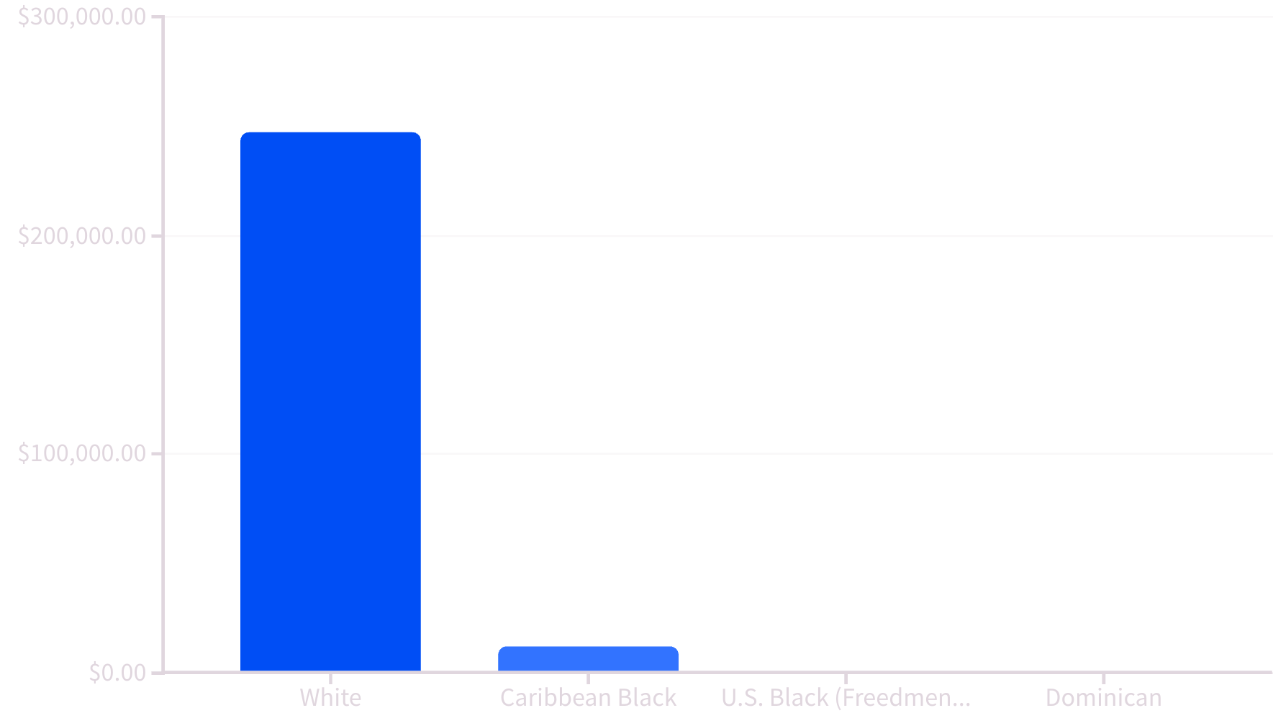
Generational Economic Exclusion and the Boston Wealth Gap
Post‑Emancipation land redistribution failed: "40 acres and a mule" was rescinded, leaving Freedmen landless and asset‑poor (1).
Exclusion from New Deal farm supports, Social Security, and the GI Bill prevented asset accumulation for Freedmen families (2).
Redlining and FHA lending policies locked Freedmen neighborhoods out of home‑equity growth (3).
Color of Wealth Boston study: median net worth for U.S. Black households is $8 vs. $247,500 for white households (4).
H.1696 & HD.3879 can create targeted homeownership grants, business capital, and debt relief for Bostonians who are descendants of U.S. persons emancipated from chattel enslavement (5).
Notes:
Speaker Notes: Hook (10 sec) – Hold up an $8 bill prop (or slide shows a giant $8). “This is the median net worth of a Freedmen family in Boston. Anyone here spend more than that on coffee this week?” (hands). “That is the wealth gap we’re here to close.”
• Story anchor – Tell the 60‑second tale of the Lewis family of Roxbury: great‑grandfather denied GI Bill loan, daughter still renting today.
• Plain‑language sidebar – “Generational wealth is like a relay race. Freedmen runners started the race without a baton—no land, no GI Bill, no FHA loan.”
• Micro‑interactions – QR‑poll: If Boston offered a $40 k first‑home grant for Freedmen descendants, would you use it or share it? Show live bar.
Transition: “We’ve seen how missing assets haunt families. But what happens when the neighborhood itself disappears? Let’s look at gentrification’s impact on Freedmen presence in Boston.”
Transition to next slide placeholder** "If economic exclusion makes a compelling moral and fiscal case, the final piece is legal protection: why Freedmen status should be recognized explicitly as a protected class to insulate remedies from constitutional attack."or Legal and political exclusion translated directly into economic deprivation. Freedmen never received the promised land that could have seeded generational wealth. Later, when the federal government poured resources into the middle class through the New Deal and the GI Bill, Freedmen were largely left out.
Fast‑forward to Boston today: the Color of Wealth report shows a jaw‑dropping gap — $8 versus nearly a quarter‑million dollars. This isn't a story about generalized racial disparity; it's the compounding effect of policies that excluded a specific legal class.
If economic exclusion makes a compelling moral and fiscal case, the final piece is legal protection: why Freedmen status should be recognized explicitly as a protected class to insulate remedies from constitutional attack.

Slide 9
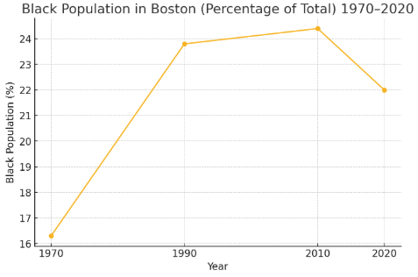
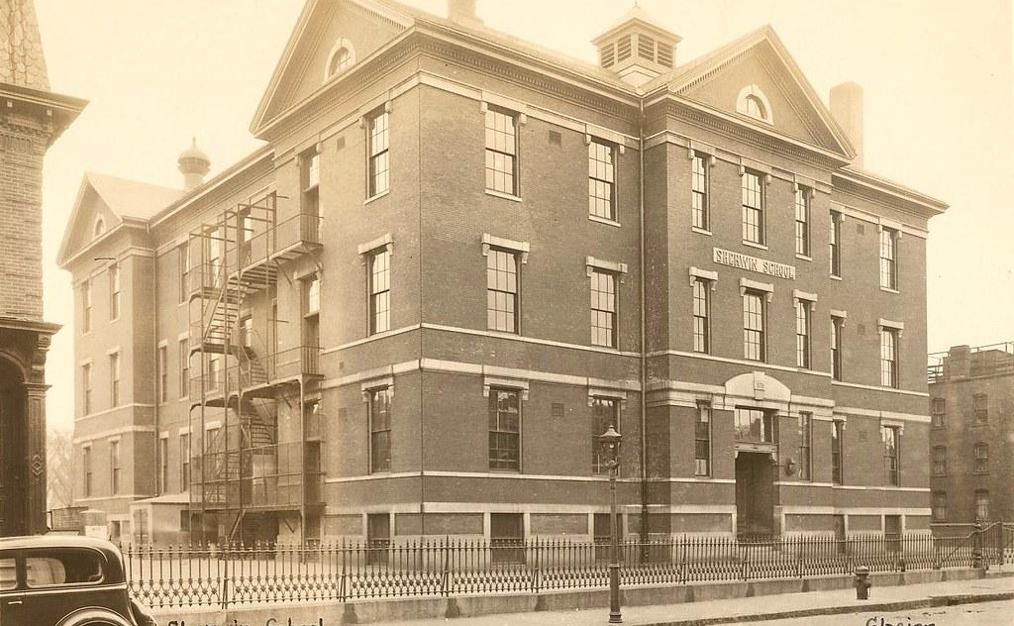
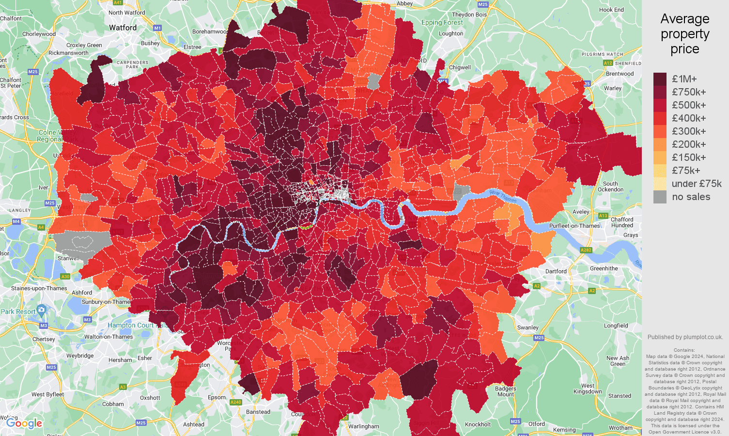
Shrinking U.S.–Born Black Population in Boston
Population Decline
Neighborhood Change
Displacement Patterns
Boston's U.S.–born Black (Freedmen‑lineage) population fell by 8,400 school‑aged children between 2000‑2017 while foreign‑born Black population rose (1).
Harvard JCHS found the Black share of residents declined in 40% of Boston‑area census tracts, especially Roxbury, Dorchester, and Mattapan—traditional Freedmen communities—since 1990 (2).
Rising home values & rents displaced long‑time Freedmen households; many moved to Brockton, Randolph, & southern states (3).
Notes:
Speaker Notes: Hook (10 sec) – “Quick show of hands: Who grew up in Dorchester, Roxbury, or Mattapan? Keep your hand up if you still live there today.” (Hands drop) “That’s the displacement story in real time.”
• Story anchor – 45‑sec vignette: Ms. Johnson, third‑generation Freedmen homeowner, forced to Brockton after taxes tripled.
• Plain‑language sidebar – “Gentrification is just a fancy word for prices outrun paychecks.”
• Micro‑interaction – Map slide includes sticky dots: invite audience to drop a virtual pin (Mentimeter) of where they or their parents moved from Boston.
Transition: “The exodus thins community power, but poverty hasn’t left with the people. Let’s rewind a century and see how stubborn that poverty line really is.”or Gentrification isn't just a buzzword—it's physically reshaping where Boston's Freedmen families live. While the overall Black population remains sizable, a growing share is foreign‑born. U.S.–born Black Bostonians—those most directly descended from those enslaved in America—are leaving core neighborhoods due to skyrocketing housing costs. This demographic shift makes it even more urgent to enact reparative policies before Freedmen vanish from the city's fabric.
Gentrification weakens community institutions & reduces political power of Freedmen voters inside city limits.
H.1696/HD.3879 can slow displacement via down‑payment grants & property‑tax relief for eligible Freedmen households.

Slide 10
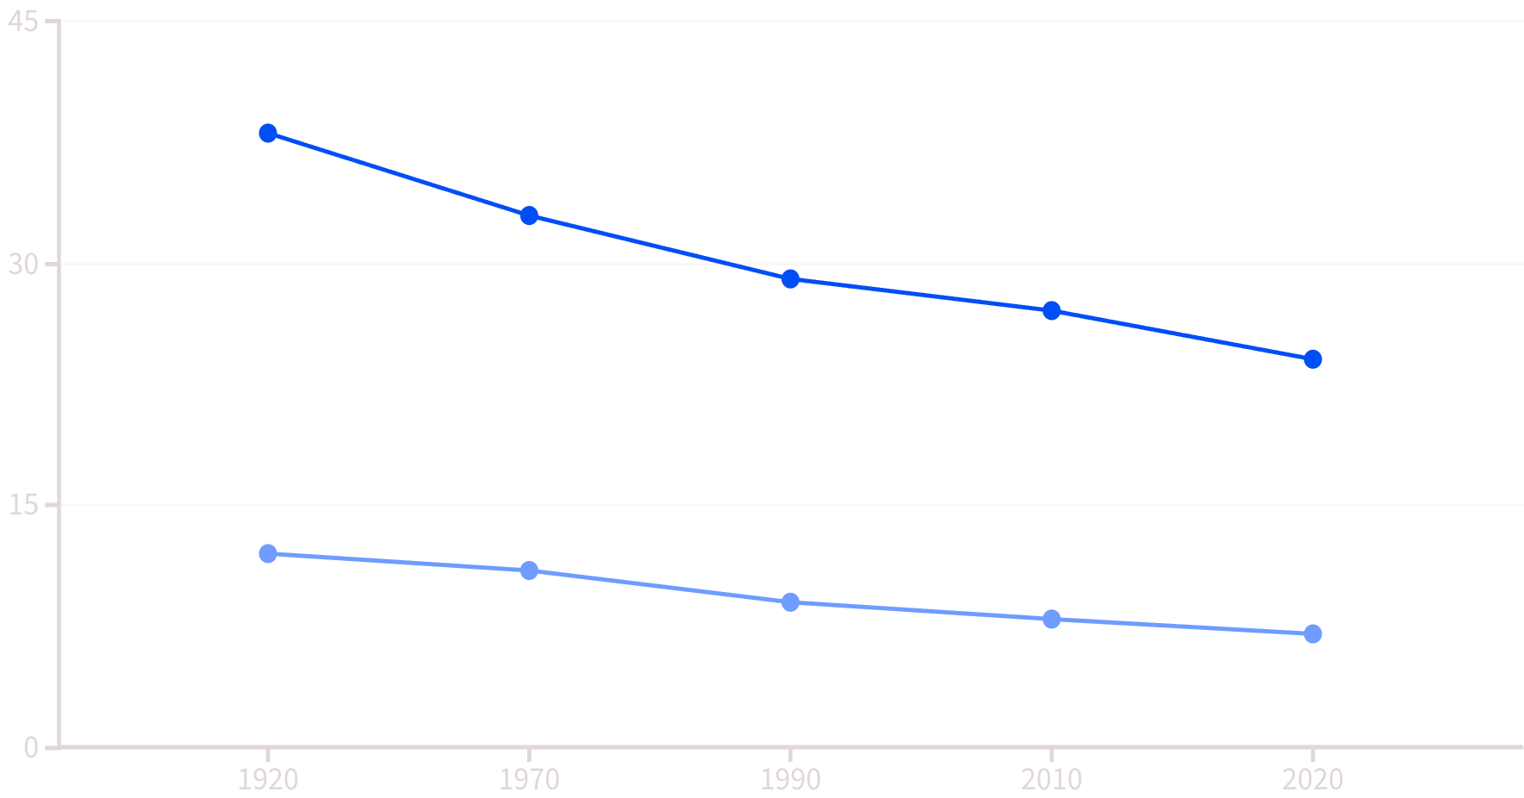
Poverty Rates Have Stubbornly Persisted
Gap narrows only slightly despite civil‑rights era gains.
Immigrant Blacks show higher incomes & lower poverty, masking Freedmen lineage hardship.
Cause differs: inter‑generational asset denial vs. immigrant newcomer challenges.
Black Poverty Rate (%)
White Poverty Rate (%)
Data derived from Census decennial & ACS 5‑yr pooled (4).
Notes:
Speaker Notes: Hook (10 sec) – Flash the line chart. “These lines barely budge in a hundred years—like a flat EKG. If a doctor saw that, they’d say the patient’s not getting oxygen.”
• Story anchor – Share Grandma Ella’s ledger: wages as a 1950s domestic, compare to her white coworker’s Social‑Security‑backed retirement.
• Plain‑language sidebar – “Poverty isn’t an individual failure; it’s a compound‑interest penalty on past policy.”
• Micro‑poll – Ask: Should Boston create child trust accounts funded by cannabis tax for Freedmen kids? Quick yes/no on screen.
Transition: “Economic scarcity is only half the picture. Let’s see how justice‑system bias and business barriers tighten the vise on Freedmen families.”When we examine poverty over the last century, a clear pattern emerges: U.S.–born Black Bostonians consistently experience poverty at three to four times the white rate. This is not because Freedmen lack ambition or education—it’s because the starting line was set generations back by law. Newer Black immigrants face obstacles too, but they often arrive with different social networks and without the weight of chattel‑slavery legacy."or When we examine poverty over the last century, a clear pattern emerges: U.S.–born Black Bostonians consistently experience poverty at three to four times the white rate. This is not because Freedmen lack ambition or education—it's because the starting line was set generations back by law. Newer Black immigrants face obstacles too, but they often arrive with different social networks and without the weight of chattel‑slavery legacy.

Slide 11
Structural Barriers Beyond Income
4.1x
808
196
3%
Incarceration Rate
Black Incarceration
White Incarceration
Business Ownership
Black Bostonians compared to white residents
Per 100,000 residents in Massachusetts
Per 100,000 residents in Massachusetts
Black-owned businesses in Boston metro
Notes:
Speaker Notes: Hook (10 sec) – “Raise your hand if you know someone who’s been locked up in Massachusetts. Now, keep it up if that person was white.” (Most hands drop.)
• Story anchor – Brief story of Marcus, a Freedmen entrepreneur denied a city janitorial contract three years straight.
• Plain‑language sidebar – “Procurement is city‑speak for ‘Who gets paid.’ Right now, Freedmen businesses practically need a secret handshake to get in.”
• Micro‑interaction – Live poll: Should Boston set aside 10 % of city contracts for Freedmen‑owned firms? Display results instantly.
Transition: “These structural barriers show why economic fixes alone aren’t enough. Freedmen need protected‑class recognition so every solution—from housing to contracts—survives the courtroom gauntlet.or "Economic exclusion shows up in two other spheres: the justice system and small‑business ownership. Freedmen are more likely to be jailed and less likely to own a business. Even with Boston’s recent supplier‑diversity push, most contract dollars bypass Freedmen entrepreneurs. Addressing these structural barriers is essential for closing the wealth gap."Black Bostonians are incarcerated at 4.1× the white rate in Massachusetts jails (Vera Institute, 2015) (5).
Massachusetts locks up 808 Black people per 100k residents vs. 196 white (2015).
Only 14% of businesses in the Boston metro are minority‑owned; Black‑owned share is under 3%, disproportionate to ~20% Black population (6).
City contracts to certified MBEs reached 11% of discretionary spend in FY 24, but Freedmen entrepreneurs capture an even smaller share (7).
HD.3879 proposes set‑asides for Freedmen businesses to close procurement gap.

Slide 12








Why Freedmen Status Warrants Legal Protection
Protected Class Status
Recognizing Freedmen as a protected class
Supreme Court Precedent
Kavanaugh, Thomas distinguish Freedmen benefits
Constitutional Authority
13th Amendment Section 2 empowers Congress
Historical Precedent
Civil Liberties Act of 1988 for Japanese-Americans
Section 2 of the 13th Amendment empowers Congress to eliminate "badges and incidents of slavery," providing explicit constitutional authority ¹.
Supreme Court language (Kavanaugh, Thomas in SFFA) distinguishes Freedmen benefits from race‑based preferences ².
The Civil Liberties Act of 1988 established a working precedent for status‑based reparations ³.
Recognizing Freedmen as a protected class can shield housing, contracting, and education programs from strict‑scrutiny challenges.
Massachusetts bills H. 1696 and HD. 3879 give the Commonwealth a vehicle to codify Freedmen status at the state level.
Notes:
Speaker Notes: Hook (10 sec) – Display two big emojis— and . “ Harvard’s race plan struck down… Japanese‑American redress upheld. What made the difference? Status.”
• Story anchor – 60‑second story of Fred Korematsu finally receiving his redress check in 1990, then ask: “Who will be Boston’s Korematsu moment for Freedmen?”
• Plain‑language sidebar – “Section 2 of the 13th Amendment is Congress’s delete‑button for slavery’s leftovers.”
• Micro‑poll – QR slide: Should Massachusetts define ‘Freedmen’ as a protected class in its civil‑rights code? Display live results.
• Reinforce bullet three in everyday terms: “When Justice Kavanaugh says ‘formally race‑neutral,’ that’s Supreme‑Court speak for constitutionally safe.”
Transition: “Okay, we know a Freedmen class can pass the legal smell test. Now let’s see why that matters when we put status‑based and race‑based programs side‑by‑side.”** "With all four pillars in place, we can now synthesize a roadmap for Boston: How do we operationalize Freedmen status into concrete, defensible policy?"or Protected‑class status is the final piece of the puzzle. Congress already used its Thirteenth‑Amendment power to abolish slavery; Section 2 lets it erase the lingering harms. By framing programs around the status of being a descendant of U.S. chattel slavery, lawmakers avoid the strict scrutiny that often sinks race‑based initiatives.
The Court itself has telegraphed this path: both Justice Kavanaugh and Justice Thomas have acknowledged that Freedmen benefits are 'formally race‑neutral.' Boston and Massachusetts can build on that reasoning. The Civil Liberties Act compensated internees and their heirs for a specific governmental wrongdoing; a Freedmen statute would mirror that logic.

Slide 13
Status‑Based vs. Race‑Based Programs
Criteria
Race‑Based
Status‑Based (Freedmen)
Judicial Test
Strict scrutiny
Deferential review (remedying a specific constitutional harm)
Historical Link
Broad racial category
Tied to U.S. institution of slavery
Over/Under‑Inclusion Risk
High
Narrowly tailored
Precedent
SFFA v. Harvard struck
Civil Liberties Act upheld
Boston Application
Legally vulnerable
Durable under H. 1696 / HD. 3879
Notes:
Speaker Notes: Hook (10 sec) – Show a scale graphic tipping toward the status column. “One side keeps crashing in court, the other keeps winning. Which one should Boston pick?”
• Story anchor – Short anecdote about the 1988 redress signing ceremony: President Reagan handing checks to internees—proof the Court didn’t strike it.
• Plain‑language sidebar – “Strict scrutiny is the legal version of a 7‑foot high‑jump bar. Status drops it to waist‑high.”
• Audience interaction – Quick show of hands: Who thinks Harvard will get its diversity numbers back through race‑neutral proxies? Contrast with status pathway.
Transition: “Even with a solid constitutional path, critics cry ‘ancestry discrimination.’ Let’s shut that argument down next.”or This table summarizes why status‑based remedies are constitutionally sturdier. Race‑based policies must jump the high bar of strict scrutiny and often fail due to over‑inclusion or under‑inclusion. A Freedmen classification is inherently narrower: it applies only to people directly linked to U.S. slavery, irrespective of skin color, and addresses a discrete historic harm.
Massachusetts can therefore design programs—housing grants, business set‑asides, educational scholarships—that focus on descendants of enslaved persons, and do so with greater confidence that courts will uphold them.

Slide 14
Why Freedmen Status Survives Challenges from Norris & Quinio
Not Ancestry for Ancestry's Sake
Constitutional Foundation
Judicial Support
13th Amendment § 2 empowers Congress (and states via delegated authority) to eradicate "badges and incidents of slavery," giving explicit constitutional footing (2).
Supreme Court signals: Kavanaugh & Thomas called Freedmen benefits "formally race‑neutral" during SFFA litigation, distinguishing them from racial quotas (3).
Freedmen is a government‑created legal status tied to a specific harm (slavery), akin to "veteran" or "internee," not a racial proxy (1).
Established Precedent
Careful Design
Civil Liberties Act of 1988 compensated Japanese‑American internees and their heirs—status‑based redress upheld for 35 years without equal‑protection defeat (4).
Drafting safeguards: narrow eligibility (proof of U.S. slavery lineage), documented harms, sunset triggers → meets "narrow tailoring" & avoids over‑inclusion.
Notes:
Speaker Notes: Hook (10 sec) – “In 30 seconds, I’ll show why ancestry discrimination is a paper tiger. First, by show of hands: who here is a military veteran or the child of one?” (Hands.) “Congratulations—you already benefit from a status‑based program.”
• Story anchor – Quick analogy: “Just like the GI Bill rewards service status, Freedmen programs repair enslavement status.”
• Plain‑language sidebar – “Status ≠ race. Status answers: ‘What did the government do to you or your ancestor?’”
• Micro‑interaction – Ask audience to shout “harm” or “race” as you list Japanese internment, slavery, hurricane relief. Emphasize harm triggers status.
• Summarize with a one‑sentence chant: “It’s the harm, not the heritage!” Have audience repeat.
Transition: “Armed with four iron‑clad pillars and a constitutional green light, the next step is action. Let’s map the road from Juneteenth to policy adoption.”or Critics such as Cameron Norris and Andrew Quinio label Freedmen benefits 'ancestry discrimination.' That argument misses the constitutional point.
– The class is defined by the state‑imposed condition of slavery, not ethnicity. – Section 2 of the 13th Amendment gives lawmakers a unique mandate to remedy that very harm. – The Court repeatedly treats status‑based reparations differently from race‑based preferences—see the Japanese‑American redress law and the justices' own language in SFFA oral argument.
When benefits are carefully drafted—limited to documented descendants, focused on eliminating concrete disparities—they are constitutionally safer than any broad racial remedy.
Bottom line: Ancestry is incidental; the legal disability is decisive—so Freedmen programs can clear the constitutional bar where race‑based plans fail.

Slide 15
References & Further Reading
U.S. Constitution – 13th, 14th, 15th Amendments https://constitution.congress.gov
Rice v. Cayetano, 528 U.S. 495 (2000) https://supreme.justia.com/cases/federal/us/528/495/
Students for Fair Admissions v. UNC, 600 U.S. ___ (2023) – Oral Argument & Opinions Opinions: https://supreme.justia.com/cases/federal/us/600/21-707/ Transcript: https://www.supremecourt.gov/oral_arguments/argument_transcripts/2022/21-707_5436.pdf
Jeffries v. State, 39 Ala. 655 (1865) https://cite.case.law/ala/39/655/
Fairfield v. Lawson, 50 Conn. 501 (1883) https://cite.case.law/conn/50/501/
Civil Liberties Act of 1988 https://www.congress.gov/bill/100th-congress/house-bill/442
Special Field Order No. 15 (1865) https://www.archives.gov/milestone-documents/special-field-order-no-15
Color of Wealth: Boston (Federal Reserve Bank of Boston, 2015) https://www.bostonfed.org/publications/one-time-pubs/color-of-wealth.aspx
Harvard JCHS – Mapping Neighborhood Change (2019) https://www.jchs.harvard.edu/sites/default/files/Harvard_JCHS_mapping_neighborhood_change_boston_january_2019.pdf
Boston Indicators – Kids Today Report (2019) https://www.bostonindicators.org/reports/report-website-pages/kids-today
Vera Institute – Massachusetts Incarceration Trends (2019) https://www.vera.org/downloads/pdfdownloads/state-incarceration-trends-massachusetts.pdf
SBA Office of Advocacy – Massachusetts Small‑Business Profile (2023) https://advocacy.sba.gov/wp-content/uploads/2023/11/2023-Small-Business-Economic-Profile-MA.pdf
Boston Equity in City Contracts Report (FY 2024) https://www.boston.gov/sites/default/files/file/2024/10/Equity%20in%20City%20Contracts%20Report%20FY2024%20%281%29.pdf
Massachusetts Bills H. 1696: https://malegislature.gov/Bills/193/H1696 HD. 3879: https://malegislature.gov/Bills/193/HD3879
Brookings – Black Veterans and the GI Bill (2020) https://www.brookings.edu/articles/black-veterans-and-the-gi-bill
Mapping Inequality – Redlining in New Deal America https://dsl.richmond.edu/panorama/redlining/
U.S. National Archives – Reconstruction Records https://www.archives.gov/research/african-americans/individuals/reconstruction

Slide 16
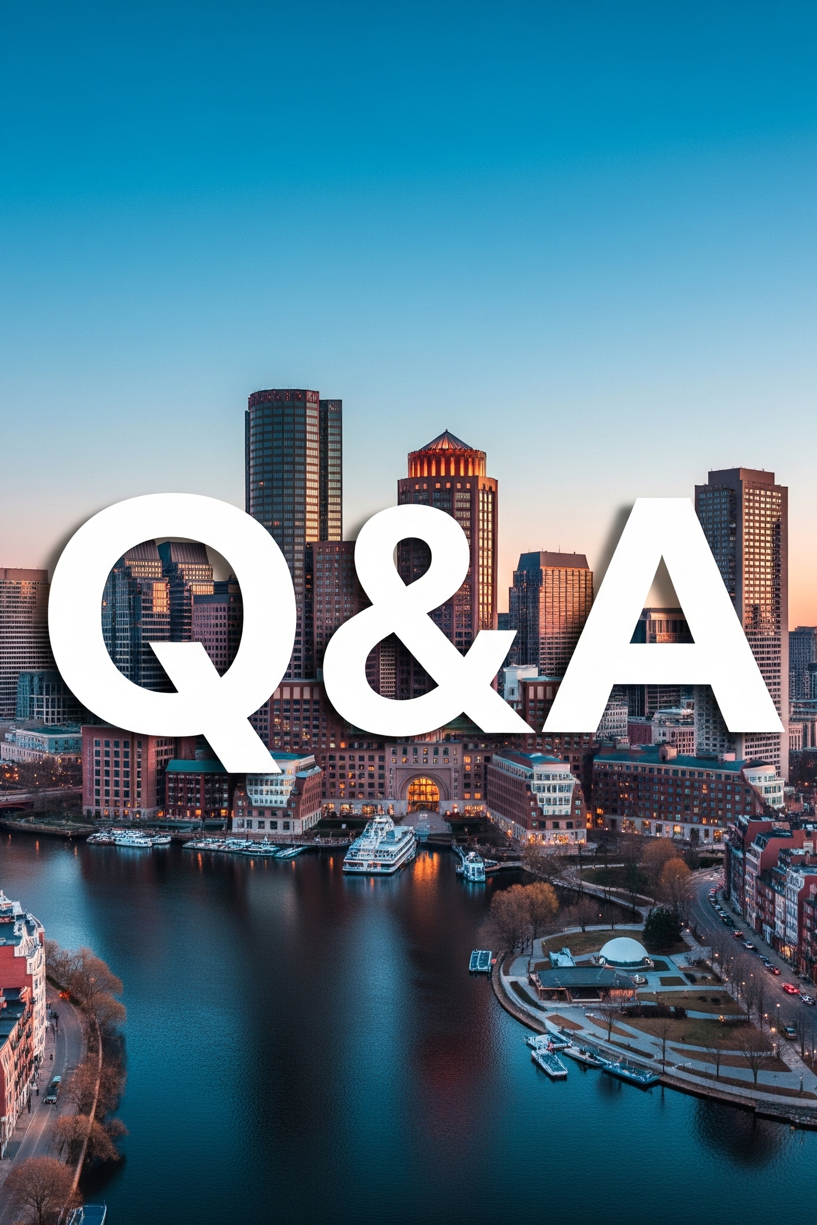
Questions and Answers
Ask About Legal Framework
Questions regarding the constitutional basis for Freedmen status and how it differs from race-based approaches
Discuss Boston Implementation
Inquiries about how H.1696 and HD.3879 would specifically benefit American Freedmen in Boston
Explore Documentation Requirements
Questions about how eligibility would be determined and what evidence would be required
Consider Next Steps
Discussion of how to support these initiatives and what individuals can do to advance the cause
please send all additional questions to: freedmen@usadof.org
Notes:
We've covered a lot of ground today, examining Freedmen status through legal, political, socioeconomic, and protected class lenses. Now I'd be happy to address your questions about any aspect of this framework and how it applies to Boston's reparations efforts.

